Slide 1
Agile Fundamentals
A Course from
ThoughtWorks Studios
CONFIDENTIAL AND RESTRICTED.
These materials are for the sole use of the individuals to whom they were delivered, and any further copying or distribution is prohibited.
Notes:
Hello, and welcome to The Origins of Agile Software Development, a module in Agile Fundamentals. This module is brought to you by ThoughtWorks Studios, makers of Mingle, Go, and Twist.

Slide 2
How much agile knowledge?
No knowledge
Expert
Notes:
Arrange yourselves around the room
Experts on one side, those with no agile knowledge on the other
Arrange yourselves in approximate order of your knowledge of agile
We call this self-organizing

Slide 3
To start…
Find a partner, so you have some balance of expertise – we call this pairing
Take an index card – write “What We Know” on top
Together, write-down up to 5 agile techniques and what they are used for
You have 5 minutes for this
One of you keep the card – we will use it later
Notes:
Have the most experienced and less experience pair, second most/second less, etc. until all paired
They can sit down, or continue standing for this exercise

Slide 4
And a second thing…
Still in your pair, take a Post-It note
Write one question you both agree on you want to answered by this workshop
Stick the Post-It on the wall over here
We will visit these questions throughout the workshop
Notes:
Have them sit at the end of this (if they are not already sitting)

Slide 5
Introductions
Who are you?
What do you do?
Why are you here?
All in 30 seconds or less.
Notes:
TIMING:
Introductions: < 5 minutes
Group Juggle: 5 – 8 minutes
Follow introductions with Group Juggle…
http://wilderdom.com/games/descriptions/GroupJuggle.html
Group Juggle
Fun way to start working together.
Can be used to learn names and develop a sense of interconnectedness.
Stand in a circle, toss a ball to someone, using his/her name, and they in turn toss it to someone else, using the next person's name.
Keep it going, then more balls are introduced and it starts gets crazy.
How to Run a Group Juggle Session
Set up & instructions for 1st round of group juggling
Arrange participants in a circle, not too close, not too far from one another
Include yourself in the circle
Explain that you are going to throw a ball to someone - pick someone out & ask their name, then say
"Hi Freddy, my name is James...here you go!" [underarm throw a ball to Freddy]
Freddy then says "Thank you James", picks someone and says "Hi X, my name is Freddy...here you go!" [throw]....they say "Thank you, Freddy] and on we go.
If you're not trying to learn names, skip the naming part & just throw!
The challenge from here is simply to get the ball thrown around to everyone in the circle, and finally back to the trainer.
2nd round of group juggling
I then say, "Right, well done, now let's see if we can that again - making sure we use the same order, and using each other's names. Remember to say the name of the person you are throwing to, and thank the person, by name, for throwing it to you, OK?"
On the second round, most people will be challenged to remember who to throw it to, and the two names! Take it slow, help the group out, so that each person has a successful second round.
3rd round of group juggling
I then say, "Good, so how about we do it again, but this time, let's let's see how fast we can do it, OK? Here we go...Hi Freddy, my name is James...." [throw]
It will go pretty fast this time, and the group will probably feel quite pleased with themselves.
4th round of group juggling - introducing more balls
I then say, "That's great, but I think you can do faster than that. Come on, let's see how we can really go..." [I then throw and say the name with super fast enthusiasm to set the tone!]
After the first ball has passed through a few hands, I take a 2nd ball out of my pocket (surprise!), and casually, but earnestly say "Hi Freddy...." [throw].
By now everyone is so well trained, the 2nd ball will automatically keep going, and there will be a detectable sense of challenge/excitement.
After a bit, I introduce a 3rd and 4th ball, up to about 6 balls.
Usually I let 4 to 6 balls be juggled for a while (note the balls will be coming back again to the trainer - just keep them going). A group of 12 adults can usually handle 4 to 6 quite well.
If I'm feeling conservative, I just let the group have the success of doing this number of balls, and collect them in when that seems to have been achieved.
But usually, once the group seems competent at 4 to 6 balls I gradually then introduce an unmanageable number of balls into the juggle & maybe also weird objects (e.g., kids soft toys) which all gets crazy, fun, out of control, etc. and ends in a hilarious shambles.
Generally doesn't require debriefing.

Slide 6
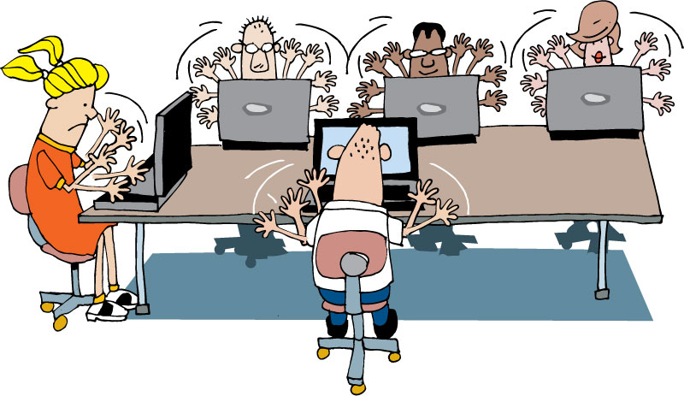
Housekeeping
Mobile phones
Laptops
Break times
Restrooms
Emergencies

Slide 7
What’s coming up…
Run an agile project
Build, test, and release a product
All using agile principles
Notes:
Introduce the concept of the Lego game, but not in great detail

Slide 8
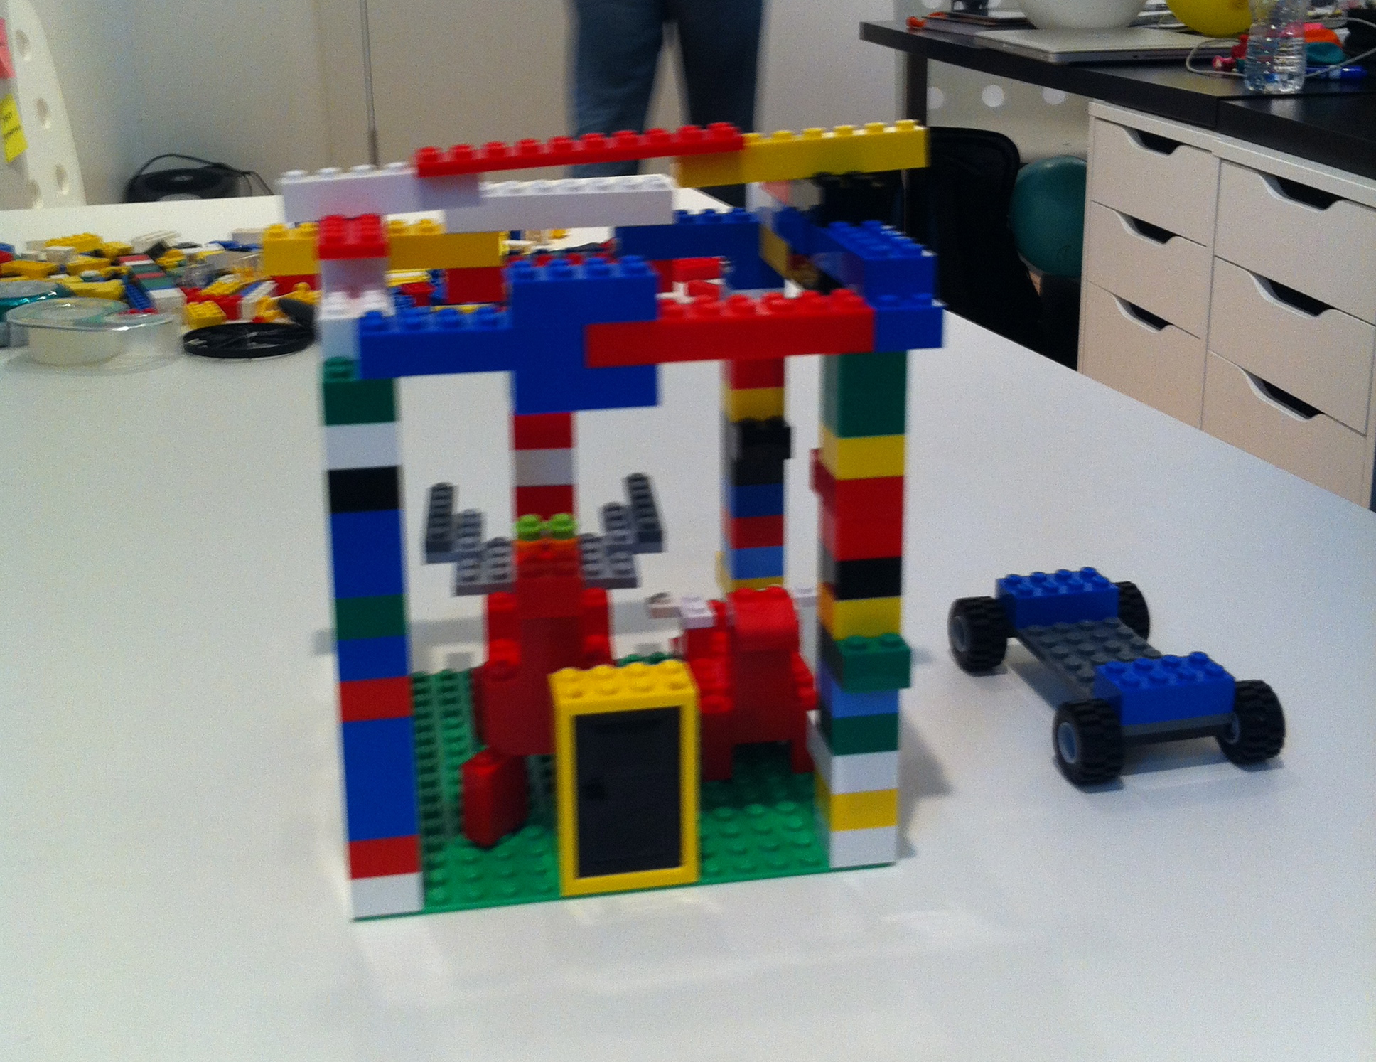
Notes:
You are going to plan, design, and build an animal using Lego’s.
To do this, you are going to understand what to build
Write some user stories
Do some estimation
Plan how you will build
Execute iterations
And finish with a new, never seen before, animal

Slide 9
The workbook
You have a workbook provided (anyone not have one?)
Has sections relating to the agile process
Is not filled with slides, but has relevant information
Please take notes! There are things you need to remember
Notes:
The notebook contains key points of agile, arranged in sections, but not every slide. They will need to take notes themselves

Slide 10

Note taking pages
Notes:
It is important participants take notes – while the workbook provides supporting information to this workshop, it’s up to the participant to record what is important to them, so they can use this information later.
There are several examples of note-taking activity pages in the workbook – explain how each one works briefly, and ask them to choose one (or more) to try. There are also blank pages for note taking.

Slide 11
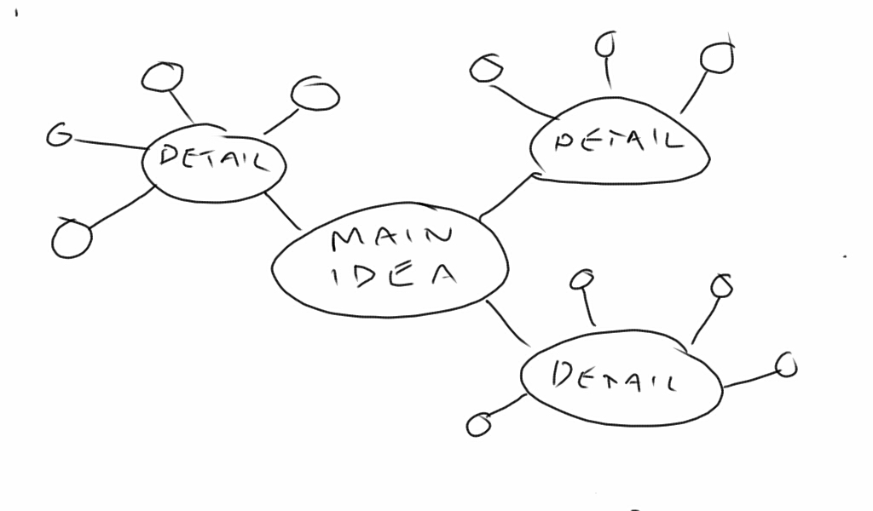
Bubble map
Notes:
Simple bubble diagram. Main idea goes in the large bubble, related ideas in other bubbles, more detail on other bubbles, etc.

Slide 12
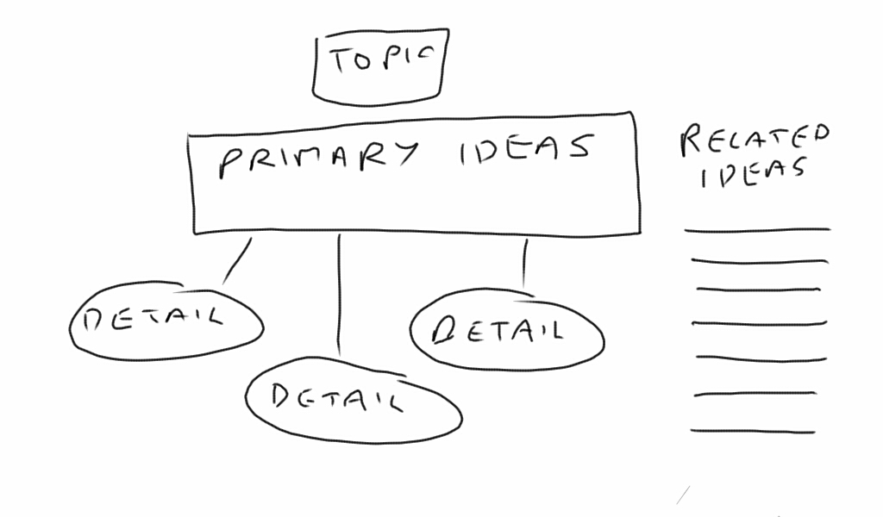
Flowchart
Notes:
Flowchart – structured
Write the topic at the top of the page.
Write each main idea under the title.
Add details in bubbles related to each main idea.
If this relates to other topics, list these at the side

Slide 13
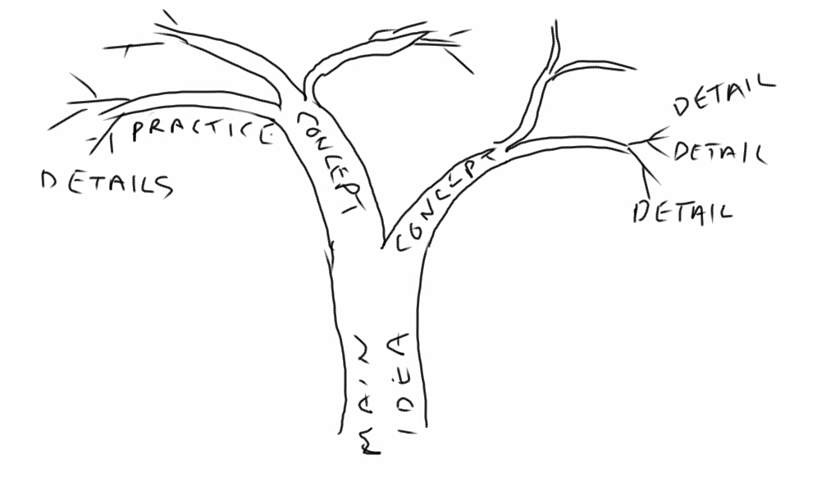
Tree and branches
Notes:
Tree diagram.
The trunk is the main idea you are learning about,
Each branch is a concept or idea related to the main topic
Each smaller branch might be a practice or idea.
You can even draw leaves for more details

Slide 14
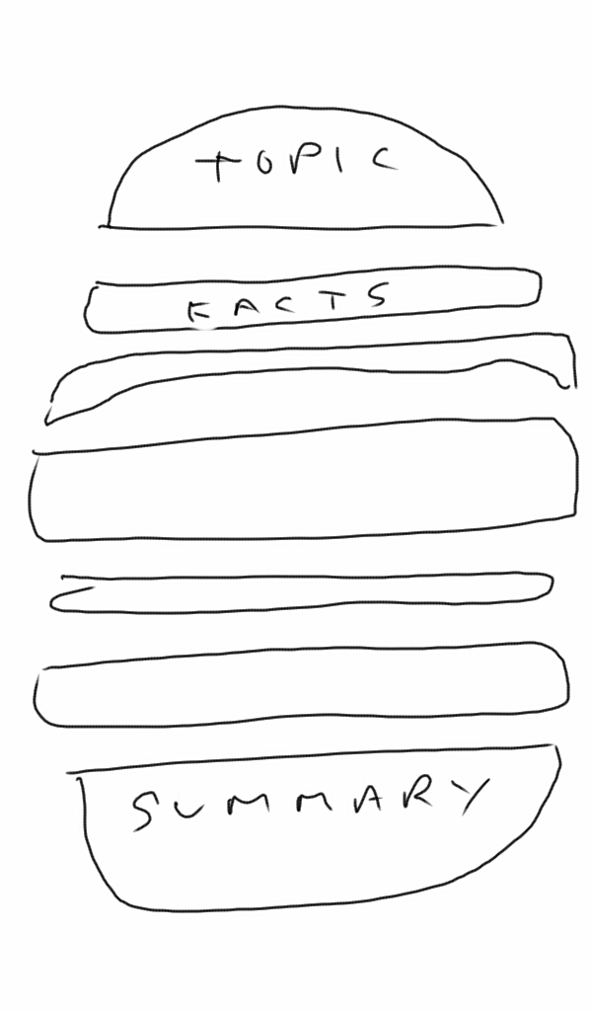
Burger
Notes:
The burger diagram.
Top bun is the main idea you are learning about
Top tomato is a fact that supports the main idea
So is the cheese, the burger, the tomato, next slice of cheese. Put as many ingredients in your burger as you hear ideas.
The bottom bun is a summary of this topic.

Slide 15
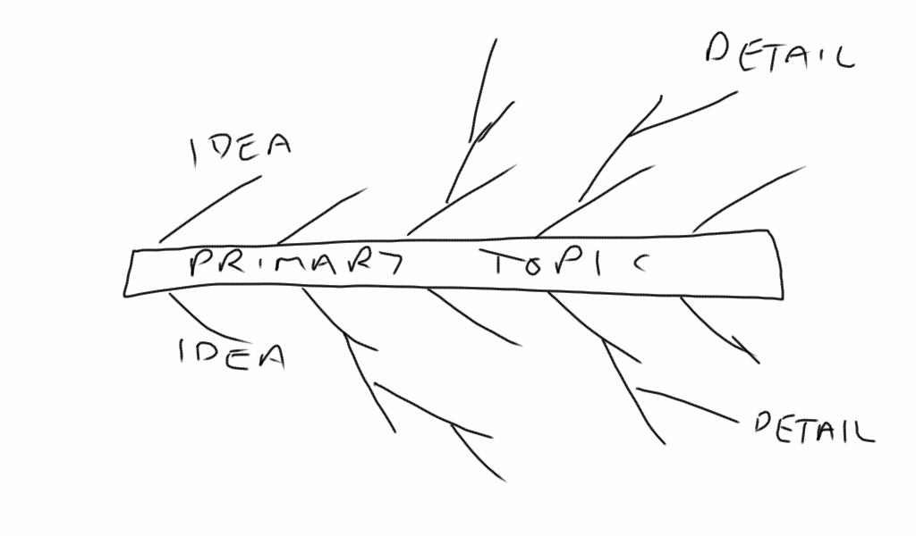
Fishbone
Notes:
Fishbone
Primary topic or idea is the main spine
Each “bone” is an idea or concept relating to the primary topic
Each smaller bone is a detail supporting the idea or concept it is related to

Slide 16
Questions?
Notes:
Thank you for joining us for The Origins of Agile Software Development, a module in Agile Fundamentals. The next module in the series is The Origins of Agile, in which we’ll look at the evolution of agile methodologies.

Slide 17
Agile Methodologies and Culture
A Module in Agile Fundamentals
Notes:
Hello, and welcome to The Origins of Agile Software Development, a module in Agile Fundamentals. This module is brought to you by ThoughtWorks Studios, makers of Mingle, Cruise, and Twist.

Slide 18
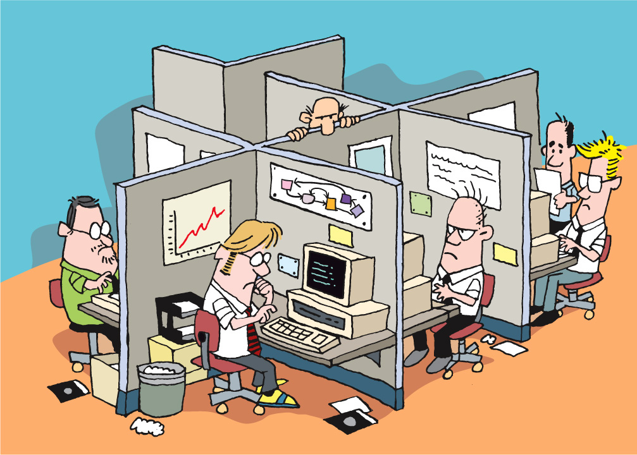

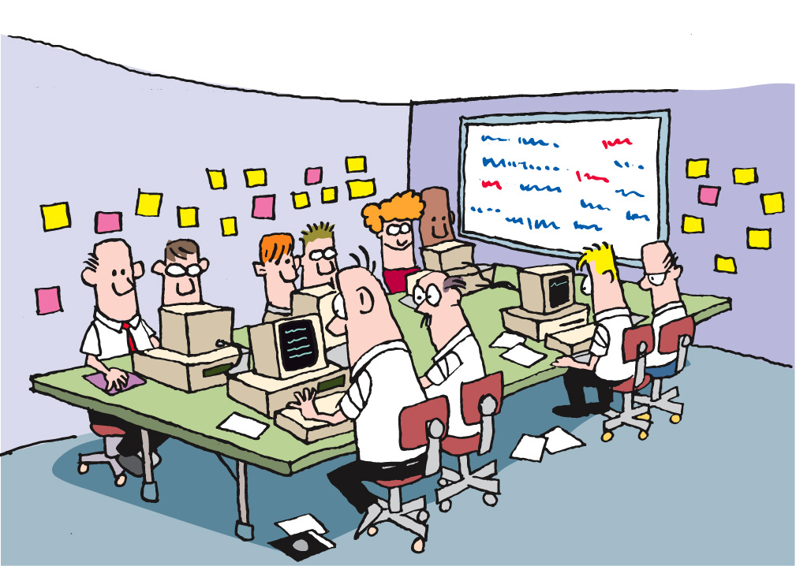
Agile Methodologies
Notes:
What type of environment do you work in?
Any of these look familiar?

Slide 19
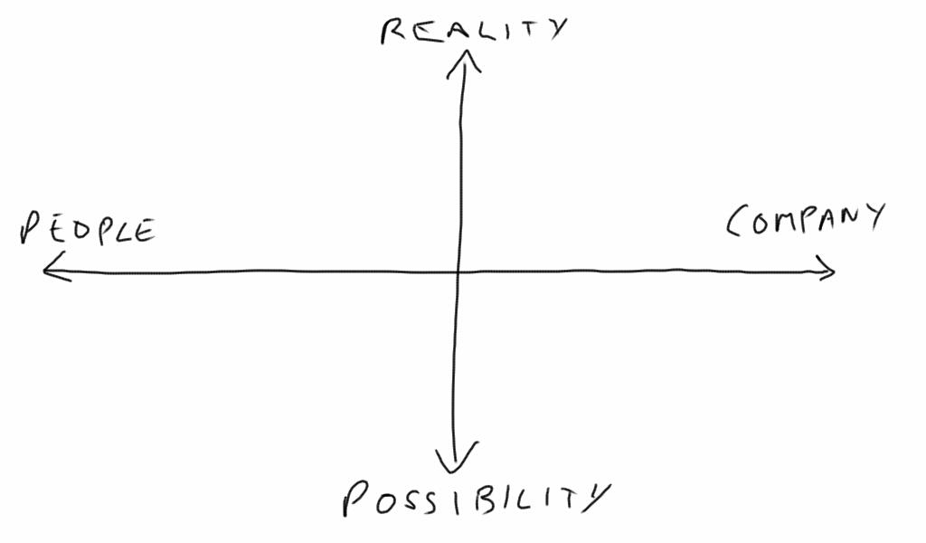
Culture
Or, how we get things done around here
We succeed by working together
We succeed by keeping control
Partnership
Trust
Process
Power
Synergy
Standardization
Collaboration
Control
Diversity
Security
Partnership
Predictability
Efficiency
Dedication
Creativity
Expertise
Cultivation
Growth
Competence
Be the best
Subjectivity
Purpose / faith
Craftsmanship
We succeed by growing people who fulfill our vision
We succeed by being the best
“The Reengineering Alternative” by William Schneider
Notes:
Need to get a feel for the culture of the organization, so we do a culture analysis.
Draw this diagram on a whiteboard or poster.
Put quadrant diagrams on the wall (3 or 4 of them).
Dot voting for culture – 3 mins
See where their cultural norms are – this will affect how the organization adopts agile.
Collaboration = agile
Cultivation = agile
Control = kan-ban
Competence = very difficult to adopt anything new – not invented here syndrome typically applies
Just information for the attendees, and they will have to pay attention to their culture.

Slide 20
What Flavor of Agile?
Scrum
Crystal Clear
Extreme Programming (XP)
Adaptive Software Development
Feature Driven Development
Dynamic Systems Development Method (DSDM)
Lean Software Development
Notes:
Lots of different flavors of Agile, and we will take a look at a few of them very quickly (these are just a few).
Question – did anybody write any of these down on their “5 agile techniques” card? Which ones did you write down?

Slide 21
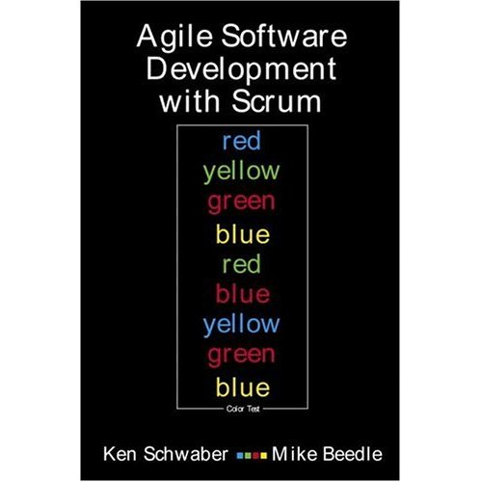
Scrum
Primarily a project management method
Project planning
Release planning
User Stories
Daily stand-up
Story points
Velocity
Notes:
Ken Schwaber developed in the late 1990’s
Approach to plan, monitor, and manage projects
Widely used

Slide 22

Extreme Programming (XP)
Primarily a developer-centric approach
Test Driven Development (TDD)
Unit tests
Pairing
Continuous Integration (CI)
Refactoring
Notes:
Kent Beck, also developed in late 1990’s
Primarily developer focused, although it shares many of the same beliefs as scrum for team dynamics and planning
Also widely used

Slide 23
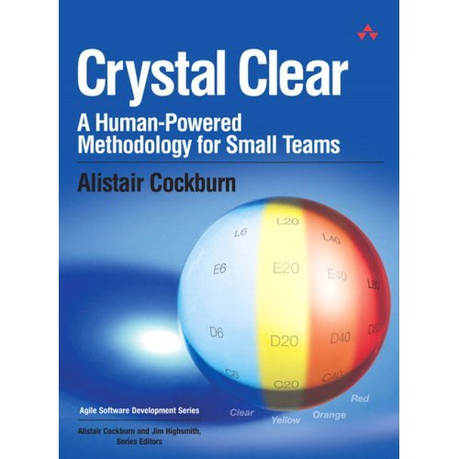
Crystal Clear
Focuses on people, not methods or artifacts
Teams of 6 to 8
Co-location
Reflective improvement
Team safety
Singular focus
Notes:
Alistair Cockburn
For non-critical, small-team, focused and dedicated development
Focuses on team dynamics, individual “belonging”, experimentation, allows failure

Slide 24

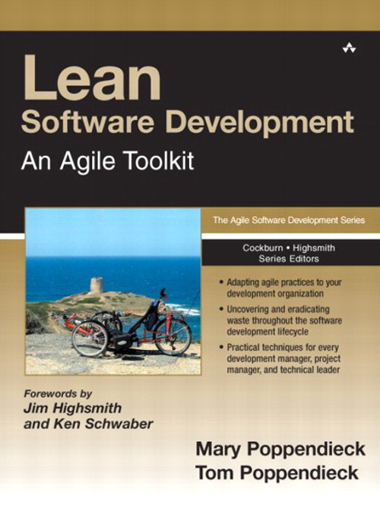
Lean Software Development
Optimize the whole
Eliminate waste
Build quality in
Learn constantly
Deliver fast
Engage everybody
Keep getting better
Notes:
Mary Poppendiek (“pop – en – dike”)
Grew out of manufacturing, primarily the Toyota Production System
Focuses on eliminating waste throughout the entire process, while building-in quality

Slide 25
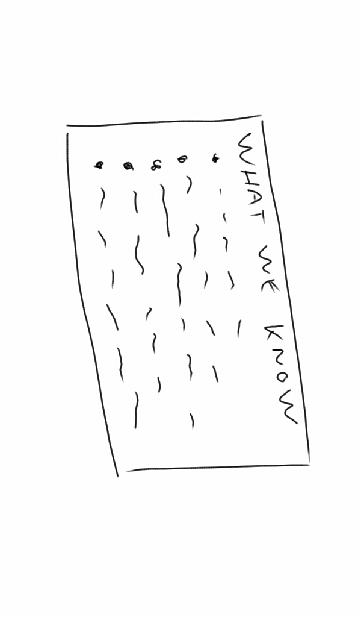
Anybody write-down any of these methods on their card?
Notes:
Check-in time. Ask if anybody wrote-down any of these methods in the card they created in their pairs at the start of the workshop.
You can give a prize to anybody who did if you like.

Slide 26
So What?
Goal
Fundamentals
Ceremonies
Techniques
Iterations
User stories
Training
Co-location
Deliver high-value, high-quality working software quickly and frequently
Short feedback loops
Task cards
Project kick-off
Story board
Burn chart
Release planning
Grooming the backlog
Inspect and adapt
Iteration planning
TDD
Collaboration and teamwork
Planning poker
Daily stand-up
Done-done-done
Review / demo
Pairing
Unit tests
Retrospective
Participate
Continuous integration
Notes:
We combine the best elements of all agile approaches, so when we talk about “agile” it can mean a range of things.
But the focus is always the same – delivering business value effectively and quickly
Don’t be fooled into thinking that if you do all the things on the right that you are agile – if you are not delivering business value, you have lost the plot.

Slide 27
Success Influencers
Notes:
Bear in mind the culture exercise earlier. How they decide to adopt agile is going to be guided by their culture, so pick appropriate adoption and communication techniques.
Bearing this in mind, we will look at techniques from several different approaches, introducing you to the most pragmatic elements for your agile adoption. Remember, we need to be pragmatic, practical, and discover what works best

Slide 28





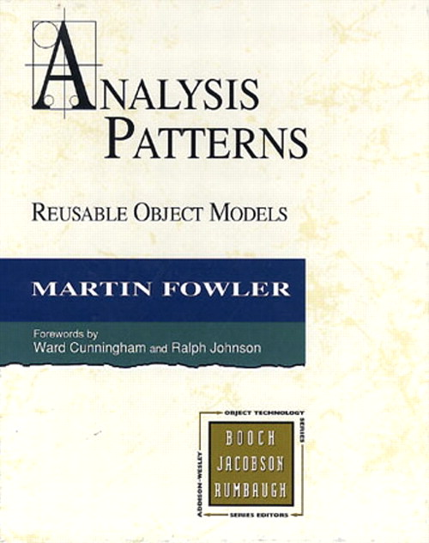
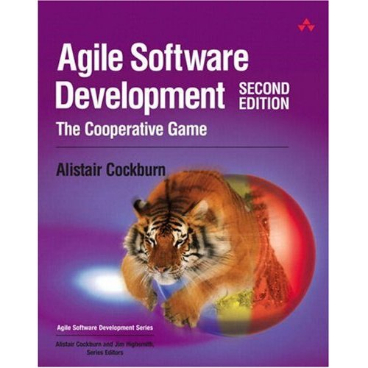

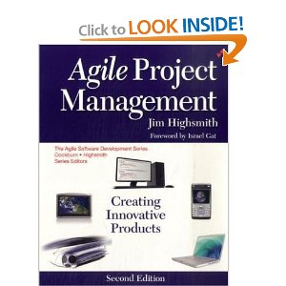
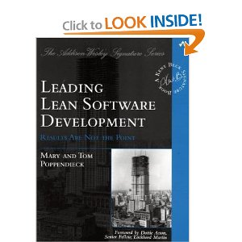
Notes:
There are lots of books on the subject of agile development, and you may want to reads some of them for yourself.

Slide 29
Notes:
What do these ideas mean to us?
Something over something else
Not instead of
Both sides have value
Items on the right have value BUT
We value the left items more
-------------------------------------------------------------------------------
Let’s talk for a few minutes about the four key ideas these folks wrote into the Agile Manifesto, and what they mean to us.
First, we’ll consider the wording. Note that every one of these is phrased as something over something else. That’s not instead of or is better than. No, it’s over. That means that both sides of the statement have value, and that the folks who authored the Manifesto were expressing a preference for one over the other.
In fact, what you don’t see on this illustration is the sentence that comes after the four points in the manifesto: “That is, while there is value in the items on the right, we value the items on the left more. “
Now let’s look at them one by one…

Slide 30
The Agile Manifesto
exercise
Preparation
Agile Manifesto in your workbook
Break into 4 groups
Discuss why you think the manifesto is arranged this way, and why the items on the left or more important to us than those on the right.
You may be asked to share your answers with the rest of the workshop
Notes:
Have them get into four groups, giving one statement to each group.
Have them discuss why the manifesto is organized this way, and what each statement means – 5 mins
Ask each group to share their thoughts on their statement. Ask the other participants their opinion or if they want to add / clarify anything after each pair presents.

Slide 31
Notes:
Individuals and Interactions over Processes and Tools
TW supports tools – creator of tools
People talking is more important to insuring the success of a project
Process and tools should encourage and facilitate conversation
Robert Frost said
“I am a writer of books in retrospect. I talk in order to understand; I teach in order to learn.”
Ernest Hemingway said
“When people talk, listen completely. Most people never listen.”
---------------------------------------------------------------------------------------
As a toolmaker, clearly ThoughtWorks Studios believes that there is value in tools and the processes that they support. In fact, all of us use tools every day in our jobs and our lives. Whether it’s a computer, keyboard, mouse, and monitor, or a toaster or a coffee maker, tools make our lives easier. What the authors of the Agile Manifesto were focusing on, however, was their belief that it is people, and the interactions between people, that are more important in ensuring the success of projects. People talking to people, and people as skilled craftspeople and experts in their fields – these are the things to focus on.
Robert Frost said “I am a writer of books in retrospect. I talk in order to understand; I teach in order to learn.” That goes right to the heart of Individuals and Interactions. Agile teams are always teaching each other and learning from each other. Tools and processes are there to free them to do these and other things, not to be the focus of their efforts.
And Ernest Hemingway said “When people talk, listen completely. Most people never listen.” The interactions between individuals require both talking and listening, along with a leavening of doing.

Slide 32
Notes:
Everyone has experienced excess documentation
US government has documents to describe documents required for projects
Requirements specs
Design specs
Functional specs
Test specs
Code documentation
Test results, etc
Much time to prepare
Maybe read once
Out of date quickly
Show vs tell
Idea came out of Rapid prototyping and collaboration
-------------------------------------------------------------------------------------------------
Working Software over Comprehensive Documentation
If you’ve been in the software profession for any length of time, you’ve either been responsible for, involved in, or the victim or beneficiary of some form of documentation or other. The US Government has documents that describe and define the documents that are required for a project. In almost every type of business, it is common to have Requirements Specifications, Design Specifications, Functional Specification, Test Specifications, Code Documentation, Test Results Reports, and so on.
The problem with this is that highly skilled people spend a significant chunk of their time writing documentation that might be read only once, if at all. Sure, the design specs and test specs will be referred to over and over during development and testing. And that’s about it.
The authors of the Agile Manifesto were focused more on show and tell than they were on writing about it. They came out of the world of rapid prototyping and engaging with the customer and the user in new ways, and thought that it made more sense to spend development time on – you guessed it – development.
Of course, there’s still a place for documentation. However, in Agile teams, we try to find ways to either have the system be self-documenting, or to simplify the documentation requirements. As you go through later modules in this course, we’ll talk about things like “test first” and TDD, user stories, showcases, and more.

Slide 33
Notes:
Contracts are to enforce agreements
Contracts are referenced when a party has not lived up to their commitment.
Specifications represent contracts.
Isadora Duncan said,
“Any intelligent woman who reads the marriage contract, and then goes into it, deserves all the consequences.”
Specs created too early are likely to change
Business changes
The economy changes
Changes require a lot of work
Negotiation
Meetings
Budgets
Lawyers
Perhaps Diane Sawyer said it best:
“I have a contract but it's not a commitment in the ordinary sense. It's our ongoing conversation.”
Spend more time talking to your customer than negotiating contracts
----------------------------------------------------------------------------------------------------------
Customer Collaboration over Contract Negotiation
Contracts are in place to enforce agreements. The only time that contracts are referenced is when one party or another has not lived up to their commitment. In software development, specifications represent contracts, if you consider that they spell out what the customer or product manager or user wants, and what the development team commits to delivering.
Isadora Duncan said, “Any intelligent woman who reads the marriage contract, and then goes into it, deserves all the consequences.” Most of us, on reading contracts, are inclined to say “that’s unenforceable” or “they’ll never make us stick to that.”
The problem is that things change. Business circumstances change. The economy changes. Our understanding of the work we do, what our customers need, or the environment in which it’s done changes. And then, if we have a contract, we have to renegotiate, with all that entails – meetings, lawyers, reviews, budgets, schedules, and so on.
Perhaps Diane Sawyer said it best: “I have a contract but it's not a commitment in the ordinary sense. It's our ongoing conversation.”
The authors of the Agile Manifesto seem to believe that it makes more sense to spend more time talking to your customer than spending time negotiating a contract. The time spent with the customer, however, should be focused on the software and the goals to be achieved and the value created or delivered by that software. That is, the time should be spent talking about the things that actually matter.

Slide 34
Notes:
Types of change we experience
Economy, Business, Consumer needs, Technology
“Do you want us to meet our delivery date, or do you want this feature added in?”
“Sure, we can do that. As soon as we renegotiate the contract, modify the project plan, get agreement from all parties, and set a new delivery date.”
Agile handles change well
Plans are good. Plans are necessary but change is inevitable.
Plan, then respond to change.
W. Edwards Deming, Plan-Do-Check-Act.
make a plan, execute against the plan, see how you’re doing, and adjust accordingly.
Colin Powell’s thought that
“No battle plan survives contact with the enemy.”
------------------------------------------------------------------------------------------------------
Responding to Change over Following a Plan
We’ve talked about change a bit already. In fact, responding to change is one of most difficult things we deal with in life, both at work and elsewhere. In most waterfall organizations, following a plan is far more important than responding to change. Many of us have found ourselves in situations where we’ve had to say “Do you want us to meet our delivery date, or do you want this feature added in?” or “Sure, we can do that. As soon as we renegotiate the contract, modify the project plan, get agreement from all parties, and set a new delivery date.”
Responding to change is one of the hallmarks of Agile. Being able to respond to changes in economy, business, consumer needs and desires, technology, or architecture is crucial to the success of software projects. And yet in Waterfall, it seems like we do everything we can to avoid change and stick to the plan.
Plans are good. Plans are necessary.
According to W. Clement Stone, “No matter how carefully you plan your goals they will never be more that pipe dreams unless you pursue them with gusto. “ This is akin to the Japanese proverb, “Vision without action is a daydream. Action without vision is a nightmare.”
According to Napoleon Hill, “Create a definite plan for carrying out your desire and begin at once, whether you ready or not, to put this plan into action.”
And then there’s Colin Powell’s thought that “No battle plan survives contact with the enemy.” Although this one is more properly attributed to Helmuth von Motlke the Elder, a disciple of Clausewitz.
All of these help us to understand the Agile approach to planning: get enough information to get started, build something, show the customer, and then respond to their feedback. Or in the terms of W. Edwards Deming, Plan-Do-Check-Act. That is, make a plan, execute against the plan, see how you’re doing, and adjust accordingly.
That is, plan and respond to change. Both.

Slide 35
Questions?
Notes:
So, now we can move-on to actually putting agile practices – all founded on these beliefs and strategies – into action.
There is no more simple lecture – everything now is listen / discuss / do. Time for some fun…

Slide 36
Agile Project Approach
A Module in Agile Fundamentals
Notes:
Hello, and welcome to The Agile Core, a module in Agile Fundamentals. This module is brought to you by ThoughtWorks Studios, makers of Mingle, Cruise, and Twist.
In this module, we will talk about some of the core concepts that make Agile what it is. Rather than talk about software, we’re going to talk about Bill…
NEXT SLIDE
The Agile Core: Story Based Development & Incremental Business Value
User Stories, Use Cases and Scenarios
Looking at the Big Picture – Is up front planning OK?
“Good Enough” Software
Release Early and Often
The story:
Actors and use cases – sterile
Actors are causal, use cases state results of that causality
Use cases are explanatory, and rarely include business value
Storytellers, customers, and stories – comes alive
Roles represent
Stories are demanding, as well as explanatory
Stories tell you why, as well as what
Stories do NOT tell you HOW
Storytellers share experience and needs
The Big Picture – is it possible to know everything up front?
has anyone had a house built? Remodeling done?
Zeno’s Paradox of the Dichotomy
http://en.wikipedia.org/wiki/Zeno%27s_paradoxes#The_dichotomy_paradox
“That which is in locomotion must arrive at the half-way stage before it arrives at the goal.” ~Aristotle, Physics VI:9, 239b10
“The perfect is the enemy of the good.” ~Voltaire
Incremental, with constant review
Fail fast, learn quickly, adapt - PDCA

Slide 37
Agile is…
Adaptive
Evolutionary
Collaborative
Just-in-time
Start with a plan
Notes:
Agile is not a “start coding and we can figure-out what the business wants later” approach.
Not a lot of published information on the entire agile project cycle, so planning and handover are often not considered
Plan well, and you can execute well
Lots of planning in agile – project level, release level, iteration level, daily through stand-up

Slide 38

Agile project lifecycle (TW style)
Initiation
Evolve / Handover (…)
Inception
Develop & deploy
Notes:
There is planning – Inception
2 – 4 weeks for a 4 – 6 month project
Flows, scenarios, stories
We need to prepare for Development – Initiation
Environment(s) set up
Narrative writing
Team processes
Develop & Deploy
Release working software
About 12 weeks of work
Common question?? How do I know how big the project is to determine how much time for Inception?
There has been a ‘Conceptualizing’ phase hopefully.
Experience. Relative sizing to other projects you’ve done.

Slide 39

Agile project lifecycle (TW style)
Many time-boxed iterations
Develop & deploy
Notes:
1 – 4 weeks
Shorter - more frequent change and increase transparency into issues and progress
Longer - accommodate the communication overhead required for larger, multi-team projects
Called a Release

Slide 40
The basics still apply
Analyze
Design
Code
Test
Deploy
Notes:
Repeating cycles of this stuff

Slide 41
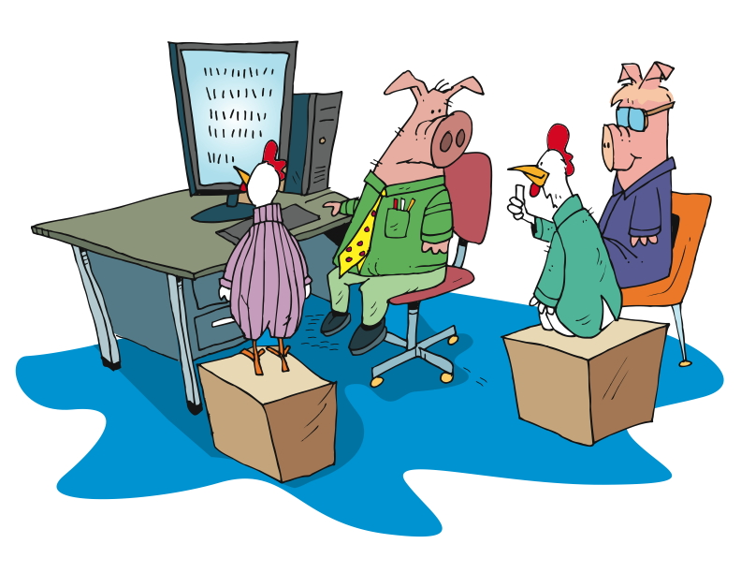
Agile project lifecycle (TW style)
Working software showcased to the business
Develop & deploy
Notes:
Talk about UAT – psychologically, people want to “kick the tires”

Slide 42
The flow
Daily stand-up
Story backlog
Prioritized subset
prepared for IKO
Iteration Kick-Off (IKO)
Showcase
Working software
Notes:
Story Backlog
List of stories for the entire project
Prioritized sub set
Prioritized for the next Iteration
Whole team
IPM
No waste
IKO
Clarify
Task
Estimate
Stand up
Short
Yesterday, today, blockers
Chickens and pigs
Showcases
Present working software
Sometimes give customer a play environment too
Customer gives feedback
New stories?
Re-plan?
Retrospective
Well, not so well
Constant improvement

Slide 43
The Team
Notes:
Who does what on an Agile team.

Slide 44
What does your team look like?
exercise
Break into groups of 4 or 5
What roles make-up your team?
Write each role on an index card.
What are their major responsibilities?
Where (physically) are these people?
How often do you communicate with them?
Write your information on the index card.
You may be asked to share your answers with the rest of the workshop
Notes:
We want to get people focusing on the entire build team, not just developers, QA’s, BA’s, etc.
This exercise is to identify the participants perception of “their” team, and how limited their view might be.

Slide 45



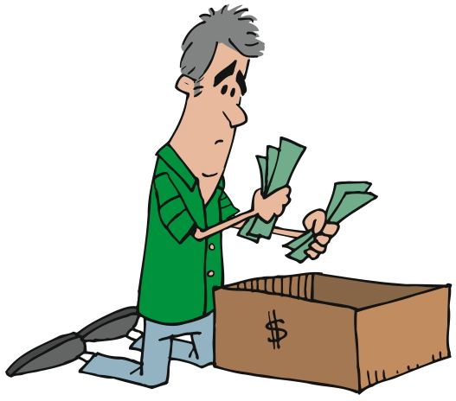


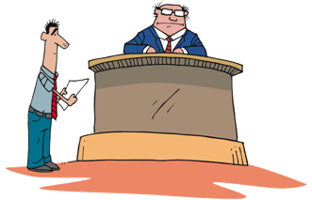

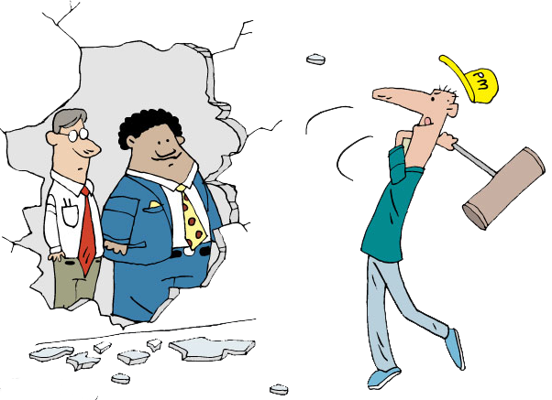
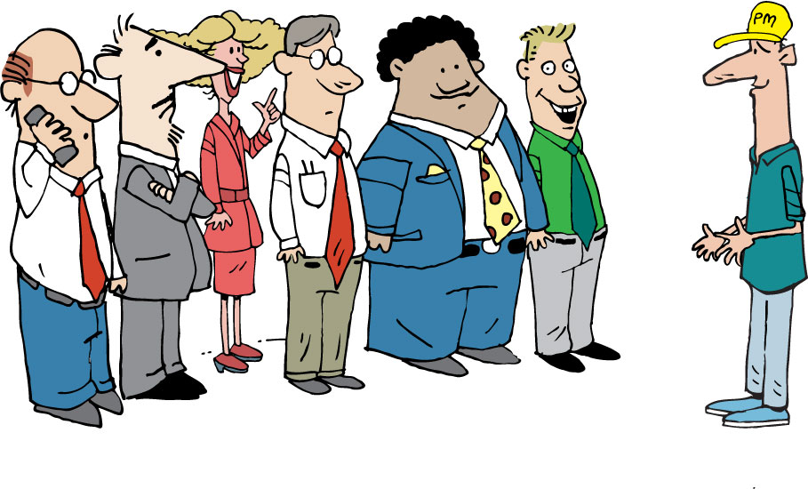




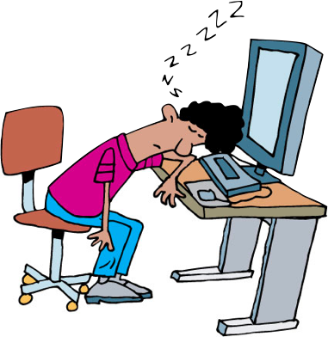


Indicative Team Composition
Extended
Team
Architects, Process Specialists and SMEs
Security Architect
Agile
Project
Team
Program Manager
Coach
Infrastructure Delivery Mgr.
Architect
Tech Lead
Product Owner
IM
Project Stakeholder Board
Business
Analyst
PM
Tester
UX Designer
Project Owner / Sponsor
Developer
Core
Team
Other Business Representatives
Operations, Integration & Support
Database Administrator
Notes:
Having an understanding of the participants view of their team, explain the TW view of teams, especially the project core team.

Slide 46
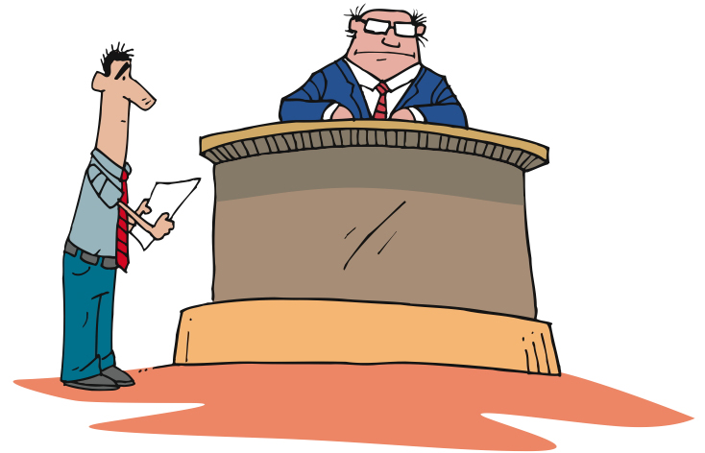
Product Owner/Customer
Provides vision for the solution
Single point of escalation for prioritization

Slide 47

Project Manager
The Agile PM focuses out
Responsible for Budget & Staffing
Coordinating with external teams and stakeholders
Notes:
Bottom line, PM is outward facing.
Supporting teams – environments, deployments, data, documentation,
Stakeholders
Executive or Steering committees
Low: 1 min
High: 3 min

Slide 48

Iteration Manager / Scrum Master
Facilitates collaborative activity
Encourages and mentors
Carries water
Removes boulders
Notes:
PM is generally outward/management facing.
Budget to actuals
Steering committee, sponsor communication/meetings
Removes technical or resource obstacles
IM –[CLICK] Iteration Manager/Scrum Master can be a different person or the same person as the PM
is generally inward/team facing.
Facilitates team meetings – standups, IPM/IKO, retrospectives, showcase (w BA)
Tracks velocity, capacity
Manages the backlog. Works with customer and BA to prioritize new stories
Maintains card wall and other project radiators

Slide 49

Business Analyst
Facilitates workshops
Understands the business needs
Focuses on business value
Manages requirements
Creates artifacts
Supports developers
Works with testers
Notes:
#1 responsibility is to truly understand the business needs, problems and..
Work with developers to propose solutions.
Facilitates sessions with business and stakeholders
Requirements gathering
Prioritization
Showcases
Requirements elicitation, elaboration,
Creates stories and development artifacts
Writes acceptance criteria with the business/customer and QA
Works with developers and testers to clarify stories

Slide 50

User Experience Analyst
Facilitates workshops
Defines usability
Conducts usability testing
Usability =
Learnability
Efficiency
Memorability
Errors
Satisfaction
Notes:
Facilitates sessions to design the most ‘usable’ design for all users
Considers different roles, users
Usability is defined by 5 quality components:
Learnability
Efficiency
Memorability
Errors
Satisfaction

Slide 51
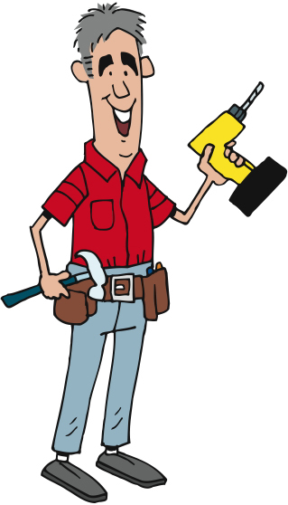
Developer
Creates working software
Adheres to coding standards
Practices TDD
Collaborates with BA and Testers
Notes:
Coding standards:
Consistent style and format for source code, either standard conventions specified by the language vendor (e.g. The Code Conventions for the Java Programming Language, recommended by Sun) or custom defined by the team
Design patterns (avoid anti-patterns) and principles, such as SOLID

Slide 52

Quality Assurance Analyst (Tester)
Declares ‘Done’
Creates test plans
Performs various tests
Updates quality metrics

Slide 53

Business Stakeholders
Represents a particular area of the business
Participates in key activities
Responds promptly
Notes:
Represents a particular area of the business (e.g. sales / marketing, legal / compliance, etc.) during the lifetime of the project
Participates in key activities, e.g. inception, release planning, showcases, etc.

Slide 54



Implementation Stakeholders
Represents areas of the delivery team
Participates in key activities
Responds promptly
Notes:
Represents a particular area of the wider delivery team (e.g. Operations)
Participates in key activities, e.g. inception, release planning, showcases, etc.

Slide 55
Questions?
Notes:
What we’ve done……
Seen how best practices address traditional project challenges
Learned the process
Met the team

Slide 56
Define the Project
A Module in Agile Fundamentals
Notes:
Hello, and welcome to The Agile Core, a module in Agile Fundamentals. This module is brought to you by ThoughtWorks Studios, makers of Mingle, Cruise, and Twist.
In this module, we will talk about some of the core concepts that make Agile what it is. Rather than talk about software, we’re going to talk about Bill…
NEXT SLIDE
The Agile Core: Story Based Development & Incremental Business Value
User Stories, Use Cases and Scenarios
Looking at the Big Picture – Is up front planning OK?
“Good Enough” Software
Release Early and Often
The story:
Actors and use cases – sterile
Actors are causal, use cases state results of that causality
Use cases are explanatory, and rarely include business value
Storytellers, customers, and stories – comes alive
Roles represent
Stories are demanding, as well as explanatory
Stories tell you why, as well as what
Stories do NOT tell you HOW
Storytellers share experience and needs
The Big Picture – is it possible to know everything up front?
has anyone had a house built? Remodeling done?
Zeno’s Paradox of the Dichotomy
http://en.wikipedia.org/wiki/Zeno%27s_paradoxes#The_dichotomy_paradox
“That which is in locomotion must arrive at the half-way stage before it arrives at the goal.” ~Aristotle, Physics VI:9, 239b10
“The perfect is the enemy of the good.” ~Voltaire
Incremental, with constant review
Fail fast, learn quickly, adapt - PDCA

Slide 57
What are we going to do?
Define the vision for our new animal
Develop what our goals are
Write user stories to develop the animal
Estimate what it will take to build the animal

Slide 58














Self-organize…
Notes:
Have everybody form into 3 or 4 teams of 6 people or so. These will be the teams that work together through the rest of the workshop to build our Lego animals

Slide 59

Establish a Shared Vision
Does the team know what the product is?
Do they have a clear, unambiguous goal?
Can the team articulate this vision?
Elevator statement
Magazine review
Press release
VC plan
Product box

Slide 60
Elevator Statement
Explains in 2 minutes what the product is
Who benefits from it?
What is the need?
How?
For people who knit
Jacob Wool provides 100% natural yarns.
They are easy to work with, colorfast, and comes in many weights.
Unlike Patons and Lion Brand yarn, Jacob Wool Yarn contains no synthetic
materials or man-made dyes, and is produced right here in Minnesota.

Slide 61
Magazine Review
Write a review you would like to see in CIO or other relevant magazine
What key features would be singled out?
What would be said about the product?
How will it compare to competitors products?
Develop a feature / competitor matrix
AA BCV CV JUH LO US
☑
☑
☑
Easy tto use
Nice screen colors
Make a nice sound
Exceptionally fast
Handles all my data
☑
☑
☑
☑
☑
☑
☑
☑
☑
☑
☑
☑
☑
☑
☑
☑

Slide 62
Venture Capital Plan
Purpose and objective
The what and why of the project
Proposed financing
How much money do you need? For what?
Marketing and sales plan
How are you going to sell it? To whom? At what price?
Description of the product
Advantages, competitors, unique features

Slide 63
Press Release
As a team, write the press release you want everyone to see
Key points about the product
Why it is better than the competition
Quotes from key individuals
CEO / Team members / satisfied pre-release customers
When will it be available?

Slide 64
Product Box
Develop a box to ship the product
Write 3 to 4 key bullet points to sell it
You have 5 seconds in a store to get someone to buy
Typically, consumers read 2 bullet points before they put the box back on the shelf
Use color, logos, and develop a brand

Slide 65
Our New Product
All the animals are becoming extinct, so you must design and build a replacement animal
It must be able to fly
It should do something to benefit mankind
As a team, decide what your animal will be
Name your animal
Develop a vision for the animal, and how you will ensure its survival
Where will it live?
Will it have children?
Who will look after it?

Slide 66
Announcing our plans
Develop a vision for your animal
What type of animal will it be?
Breeding plans
Care and development
Where will it live?
What will you call it?

Slide 67
Roles & Goals
Notes:
The techniques discussed here are similar to traditional analysis techniques.
Agile does them quicker and at a higher level.
Agile uses index cards and post its and other fun office supplies to elicit and temporarily capture the data.
Understand just enough to make an estimate.
Understand just enough to get a fully formed picture of the solution, but not every detail.
Low: 1min
High: 3min

Slide 68
Roles and Goals
Who am I?
What do I want to do?
How will you support my goals?
Importance
Managing Director
“I’d like to easily see the status of Customers’ invoices”
Provide online information regarding Customers’ accounts.
5
Administrative Assistant
“ I need to generate a lot more letters than I do today”
Provide an automated approach to letter generation.
2
Technology Manager
“ I want to easily support all users”
Provide a solution in a language I can support.
4
Sales
“ I want to be able to sign on more customers with confidence.
Provide a system that can accommodate additional customers with the quality service.
3
Customer
“ I need to be confident that DC knows the status of each of my debtors’ invoices”
Provide a way to reflect invoice status by Debtor.
1
Notes:
Understand the differences between users of the same role.
Admin asst.
Sales. Manager, Sales folks.
Is Customer a role we should track?
Low: 3min
High: 6min

Slide 69
New animal roles
Who am I?
What do I want to do?
How will you support my goals?
How important am I?
Determine what roles will be interested in your new animal
Answer the questions below in developing their goals
Goals & Roadblocks
What are their goals in their job?
What are their personal / career goals?
What are common frustrations in their job?
What are daily roadblocks?
Context of use
What are their 3 most common tasks?
What are their 3 important performance metrics?
HINT: Think of people in the entire animal’s development – zoo keepers, wildlife experts, the general public, environmentalists, etc.
Notes:
Using a flip chart and whatever other materials, please provide the following information for your role.
Roles:
Managing Director
Administrative Assistant
Technology Manager
Sales Person
Sales Manager
Customer
Low: 15min
High: 30min

Slide 70
Personas
Notes:
Low: 1min
High: 3min

Slide 71
Understanding Users
First, we need to answer some questions:
Who will be using our software? (Roles)
Why will they be using our software? (People)
What important characteristics do these people possess?
Notes:
We know what Roles need to use our software,
but do we know the differences in the way different people of same role will use the system?
It is people who use our software, not roles, so we need to consider the characteristics of these people as we design our solution

Slide 72
What is a Persona?
Archetype / representation / profile
Description of end users
Reference document
Notes:
How many of you have heard of, worked with, created personae before?
You are not a user!
Create personas to bring the users to life
Fictional name, not Customer 1, but Ryan Green
Personas are about behavior patterns – they are not job descriptions
They act as a frame of reference throughout the Inception and development. “How would Ron feel about this?”
Use pictures to help the team see the personas as real people
Original bullets:
An archetype, representation or profile of our end-users
A description of our end-users that includes:
An overview of their role and their goals
Details of key characteristics
A name and a photo that give a human touch
A reference document to focus future discussion and debate
Low: 2min
High: 5min

Slide 73
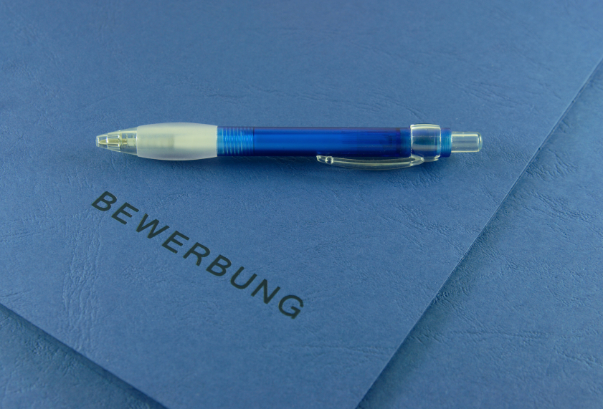
Attributes of a Persona
Biographic
Technographic
Demographic
Knowledge and experience
Psychographic
Goals, needs, desires, attitudes, motivations
Notes:
Biographic
The personal story of their life. Where they grew up, where they went to school, marital status
Demographic
Vital statistics. Age? How long have they worked there? # of people in that role?
Low: 1min
High: 3min

Slide 74
How to develop personas
Identify roles and goals
Distribute behaviorally
distinct traits
Assign attributes
Personas
Notes:
For the administrative staff, how many different behaviors do you think we have with 20 folks?
Low: 2min
High: 5min

Slide 75
Personas
Take one of the roles you developed earlier
Could multiple personality-types do this role?
Develop 2 personas for this role

Slide 76
Collecting Stories
Notes:
Stories are the unit of work that gets measured, tracked, signed off.
Let’s talk about …………
Techniques for writing stories
Techniques for planning with stories
First the template
---------------------------------------------------------------------------------------------------------
While we talked about Stories in an earlier module on The Agile Core, we didn’t talk much about the process and the practices. Since Stories are one of the key tools in an Agile project, we’re going to talk a bit about some of the techniques that will help you in writing stories and working with them as part of the planning process.
Let’s start by reviewing the template for a user story.

Slide 77
User Stories
Three C’s
Card
Conversation
Confirmation
As a Librarian, I want to be able to search for books by publication year so that I can produce a chronological index
Notes:
Ron Jeffries – ‘Extreme Programming Installed’
Aspects of user stories
[CLICK]
Card – index card or virtual
Repository of information that is the requirements
Placeholder for [CLICK]
Conversation
Not enough info in the card
Has all the parts – Role, Goal, Value
What would the search results look like?
What are the search criteria?
Have the conversation when ready to do the work
Conversations with business, developers, testers
Document enough to do the work
[CLICK]
Confirmation
How we know the story is ‘done’
Acceptance criteria
“I will know this is complete when…..”
Story level acceptance criteria
---------------------------------------------------------------------------------------------------------------------------
You might say that User Stories are the “currency” of Agile Software Development. They are the central elements that identify what we’re doing and why we’re doing it.
Let’s consider the key aspects of User Stories.
First, there’s the Three C’s. [CLICK]
The first C is the Card, or story. Whether you are working in a physical world, and using index cards, or you are working in an electronic world like Mingle, and using virtual cards, this artifact serves two purposes: first, it is the repository of the information that is the story and is about the story; second, it is a placeholder for a future [CLICK]
Conversation. If you examine the story we have here, it is pretty obvious that there is not enough information here to know precisely what to build. It does follow the template, of course – the role is Librarian, the Goal is to have the capability to search books by publication year, and the value is so that a chronological index can be produced. But what would the search results look like? What would I do with them?
In order to clarify these questions, we would wait until we were ready to start development on our story, and then we’d have the Conversation. In the conversation we would dig into the details, figure out enough for the developers and testers to do their work, and document just enough of that information to enable us to do the work.
The third C is Confirmation. This is the combination of Acceptance Criteria and the actual testing to confirm that the goals and value of the story have been satisfied.
Without all three C’s, the story is not effective as a tool to guide the development of the software.

Slide 78
User Stories
Three C’s
INVEST
Card
I
Independent
N
Negotiable
Conversation
V
Valuable
E
Confirmation
Estimatable
S
Small
T
Testable
As a Librarian, I want to be able to search for books by publication year so that I can produce a chronological index
Notes:
Guidelines for writing good stories
Independent
Sales amount, sales percent, discount amount, discount percent
May want to split it – too big to fit into an iteration
Reports example. Or business rule applied to different products.
Write each as if they were the first story
Negotiable
Not a contract of what the software must implement
Conversations bring out details
Negotiate implementation, design
Get external links example.
Valuable
Valuable to the business, user, customer
This is the ‘So that’ part of the template
Everyone on the team should be able to articulate the value of the story
Estimatable
Clear and complete enough for the developers to estimate
If split as above, estimate the whole work for each.
Once foundation is complete, re-estimate the later stories
Small
Mike Cohn said it well:
“Like Goldilocks in search of a comfortable bed, some stories can be too big, some can be too small, and some can be just right. Story size does matter because if stories are too large or too small you cannot use them in planning.”
Must be completed in an Iteration.
Testable
Mike Cohn again:
“Stories must be written so as to be testable. Successfully passing its tests proves that a story has been successfully developed. If the story cannot be tested, how can the developers know when they have finished coding?”
----------------------------------------------------------------------------------------------------------
Next we have one of the key acronyms that helps us write and judge effective user stories: INVEST. This is one that you’ll want to learn, because you’ll find yourself using it all the time.
[CLICK] The I stands for Independent. As a valuable goal, we strive to ensure that each of our user stories is independent. That means that we try to write them in such a fashion that they can be estimated and implemented independently of other user stories. We’ll get into this in more detail later, because it’s such an important point. For now, let me give you an example: when working on a business intelligence project, a team wrote a story that included four measures in its Goal: sales amount, sales percent, discount amount, discount percent. At the first writing, this seemed to be a reasonable story. After a bit of understanding and experience was gained, it became clear that it made sense to break this into four stories. Of course, the development team’s first reaction was that they had to pick one story to do first, so that they could do all the underlying work with that story. That would mean that the other stories would be dependent on that story getting done first. This is a mistake that many teams make when working with stories. When we get further down in the INVEST acronym, we’ll talk more about why this is so.
[CLICK] The N stands for Negotiable. This means that stories are not written contracts or requirements that the software must implement. Story cards are short descriptions of functionality, the details of which are to be negotiated in a conversation between the customer and the development team. Because story cards are reminders to have a conversation rather than fully detailed requirements themselves, they do not need to include all relevant details. This allows room in the discussion, at the time the story is implemented, to negotiate some of the details and the implementation.
[CLICK] The V stands for Valuable. This means that it is valuable to purchasers or users of the software, and also means that it is valuable to the business. As we discussed earlier, when reviewing the story template, being able to articulate the value of a story is essential. Without being able to articulate and understand the value, it is reasonable to question why we’re writing or implementing a story.
[CLICK] The E stands for Estimatable. That means that a story must be at a fine enough granularity, with enough clarity and detail, that the team is able to estimate it. Let’s go back to the story we introduced when talking about the “I” for Independent. When this story first came up – the story including the four measures – the team estimated it relatively high, because of the combination of foundational work – adding to and modifying the database, for instance – and the detail required for each of the measures. Upon reflection, as noted earlier, the team opted to separate this story into four separate stories, one for each measure. The problem was with that Independence. They said “if we implement any one of these stories first, it will be an eight – any other story will be a two after that – so which story should we do first?” The answer was to estimate them all independently, as if they were going to do all of that foundational work on all of them. Of course, we know that that would not be the case, but it enables the team to maintain that independence. When it came time to choose among the stories for implementation, that left the Product Owner with the freedom to choose any of them, based on current priorities. Once the first story was done, the team could then re-estimate the remaining stories with the understanding that the foundational work had been done and the remaining stories would be easier to implement.
[CLICK] The S stands for Small. Mike Cohn said it well: “Like Goldilocks in search of a comfortable bed, some stories can be too big, some can be too small, and some can be just right. Story size does matter because if stories are too large or too small you cannot use them in planning.” Further, Mike says “The ultimate determination of whether a story is appropriately sized is based on the team, its capabilities, and the technologies in use.” When we work with Agile teams, one of the guidelines we use is whether a story can be completed in an Iteration.
[CLICK] And finally, the T stands for Testable. Let’s quote Mike Cohn again: “Stories must be written so as to be testable. Successfully passing its tests proves that a story has been successfully developed. If the story cannot be tested, how can the developers know when they have finished coding?”
Remember the acronym – INVEST – Independent, Negotiable, Valuable, Estimatable, Small, and Testable.

Slide 79

Parts of a Story
Unique #:
Title:
Description:
As a
I want to
So that
Assumptions:
Estimate:

Slide 80
Parts of a Story
I will know this is complete when…….

Slide 81
User Story Template
Role: As a …
Goal: I want/need …
Value: So that …
From User Stories Applied: For Agile Software Development by Mike Cohn
Notes:
From Mike Cohn’s book “User Stories Applied”.
Role
Identified during inception
Identifier for a common set of tasks or permissions
[CLICK]
Goal
What the user wants to do, not what the system is supposed to do.
The feature
[CLICK]
Value
Why are we building this functionality?
Should tie back to a business objective
--------------------------------------------------------------------------------------------------------------------
The story template we use comes from Mike Cohn’s book “User Stories Applied”. It has three parts:
The Role: this is an identifier for a common set of tasks or permissions.
The Goal: this is what is to be accomplished. This is stated in terms of what the person or role wants to accomplish, not what the system is supposed to do.
The Value: this is one of the most important parts. Without understanding what this story means to the person in the role or the organization – the business – we are left asking the question “why are we doing this?” The value statement may be the hardest part of user stories. Expressing the role and the goal are generally pretty clear, although we’ve seen some challenges there too. The value, though, is hard. People are inclined to say things like “because that’s my job!” or “so that we can do our business.”
We’ll come back to this template repeatedly as we go, because it’s such a key part of what we do and how we do it.

Slide 82
Story jam!
Write some user stories for the animal
What should the animal look like?
Break it down into legs, head, appearance, etc.
Will is have a baby?
Where will it live?
Who will look after it?
Write as many stories in 20 minutes as possible, from a range of viewpoints
Notes:
Get them writing stories quickly, and give guidance to each team. This will be very difficult at first, but they will soon get the idea, and write lots of stories.
Use Sharpies, index cards.
Don’t worry about acceptance criteria yet

Slide 83
As Steve (persona)
I want the animal to be big enough to carry me when it flies
So I can get around easily
As a homeowner
I want an animal that will protect my property
So that I can keep my family safe
As an animal owner
I want to animal to be and furry
So I can stroke it when it sits on my lap

Slide 84
Acceptance Criteria
Notes:
Stories are the unit of work that gets measured, tracked, signed off.
Let’s talk about …………
Techniques for writing stories
Techniques for planning with stories
First the template
---------------------------------------------------------------------------------------------------------
While we talked about Stories in an earlier module on The Agile Core, we didn’t talk much about the process and the practices. Since Stories are one of the key tools in an Agile project, we’re going to talk a bit about some of the techniques that will help you in writing stories and working with them as part of the planning process.
Let’s start by reviewing the template for a user story.

Slide 85
Inception Acceptance Criteria
I’ll know this is complete when…….
Notes:
Inception level vs. Iteration level criteria
Inception - I’ll know this is complete when …… [CLICK]
Iteration Level…
Given – preconditions to the story. State of the system, object, role [CLICK]
When – the action[CLICK]
Then – the result
Gives context for estimating
Security is a good example.
I’ll know this is complete when each role logs in and they receive the proper access or not.
vs. each role spelled out in the Narrative as a separate Given, when then statement.
When each statement is fulfilled, the story is done
-------------------------------------------------------------------------------------------------------------------------------
Now that we have a story, we need to address that Testable attribute. We do this by defining the acceptance criteria. That is, we identify those criteria which, when met, allow us to assert that the story has been completely and successfully implemented.
While there are many ways to phrase or write the acceptance criteria, we prefer the scenario template devised by Dan North and Chris Matts, and first documented in an article by Dan published in Better Software magazine in March of 2006. You can read it on Dan’s blog at dannorth.net/introducing-bdd as you’ll see on the slide.
The template has three clauses, like the user story template. In this case, they specify…
[CLICK] the initial context, using the keyword “given”. This clause identifies the pre-existing conditions that must exist before we can execute or experience…
[CLICK] the event, or action, which is specified using the “when” keyword. Finally, we specify…
[CLICK] the outcomes or expectations using the “then” keyword. Here’s an example…
[CLICK] First, the context – the user must not be logged in. Note that the Given – the context – is NOT part of the test, but rather is the set-up. That is, in this case we assume that the ability to log in and the permissions associated with that logging in have been dealt with elsewhere. This particular scenario is focused on verifying that a user is required to log in before being able to click on the Shopping Cart link. It is not focusing on whether or not it is possible to log in.
Once the context is set up, then we have the specific event, or behaviour, that is executed. This is the action in the test. In this case, the action is to click on the Shopping Cart link.
Finally, the scenario specifies one or more outcomes. In this case, the user should be required to log in. This might more properly be written “a login form is presented to the user” since that is measurable.
It’s important to note that there may be multiple parts to the Context – the Given clause – and to the Outcomes – the Then clause – but there will normally be only a single part to the Event – the When clause.
The acceptance criteria should be written so that they are executable, preferably in code.
We’ll talk about when to add the acceptance criteria to a story later in this module.

Slide 86
Done, done, done…
The code passed all my unit tests and integration tests, so I am done…
The code works as I expected it to, so I am done…
The code does what I need, and works as I expected it to, so it is done…

Slide 87
Inception Acceptance Criteria
“I will know this is complete when……”
As a CSR, I want to sign on to the system, so that I can see my work queue.
I will know this is complete when I have entered my login and password correctly and my work queue with the following data is displayed. See screen for details.
Alternative path may include if there are no items in the queue.
Alternative path may include if I am not an authenticated user.
Notes:
There are typically more than one path
Try to think of them at this point. Don’t worry about the results for each path.
The more you identify up front, the better your estimate will be.
Low: 1min
High: 3min

Slide 88
Iteration Acceptance Criteria
The Context: Given…
The Event: When…
The Outcomes: Then…
Given that the user is not logged in
When the user clicks on the Shopping Cart link
Then they should be required to log in
Reference: Dan North’s Blog @ http://dannorth.net/introducing-bdd
Notes:
Inception level vs. Iteration level criteria
Inception - I’ll know this is complete when …… [CLICK]
Iteration Level…
Given – preconditions to the story. State of the system, object, role [CLICK]
When – the action[CLICK]
Then – the result
Gives context for estimating
Security is a good example.
I’ll know this is complete when each role logs in and they receive the proper access or not.
vs. each role spelled out in the Narrative as a separate Given, when then statement.
When each statement is fulfilled, the story is done
-------------------------------------------------------------------------------------------------------------------------------
Now that we have a story, we need to address that Testable attribute. We do this by defining the acceptance criteria. That is, we identify those criteria which, when met, allow us to assert that the story has been completely and successfully implemented.
While there are many ways to phrase or write the acceptance criteria, we prefer the scenario template devised by Dan North and Chris Matts, and first documented in an article by Dan published in Better Software magazine in March of 2006. You can read it on Dan’s blog at dannorth.net/introducing-bdd as you’ll see on the slide.
The template has three clauses, like the user story template. In this case, they specify…
[CLICK] the initial context, using the keyword “given”. This clause identifies the pre-existing conditions that must exist before we can execute or experience…
[CLICK] the event, or action, which is specified using the “when” keyword. Finally, we specify…
[CLICK] the outcomes or expectations using the “then” keyword. Here’s an example…
[CLICK] First, the context – the user must not be logged in. Note that the Given – the context – is NOT part of the test, but rather is the set-up. That is, in this case we assume that the ability to log in and the permissions associated with that logging in have been dealt with elsewhere. This particular scenario is focused on verifying that a user is required to log in before being able to click on the Shopping Cart link. It is not focusing on whether or not it is possible to log in.
Once the context is set up, then we have the specific event, or behaviour, that is executed. This is the action in the test. In this case, the action is to click on the Shopping Cart link.
Finally, the scenario specifies one or more outcomes. In this case, the user should be required to log in. This might more properly be written “a login form is presented to the user” since that is measurable.
It’s important to note that there may be multiple parts to the Context – the Given clause – and to the Outcomes – the Then clause – but there will normally be only a single part to the Event – the When clause.
The acceptance criteria should be written so that they are executable, preferably in code.
We’ll talk about when to add the acceptance criteria to a story later in this module.

Slide 89
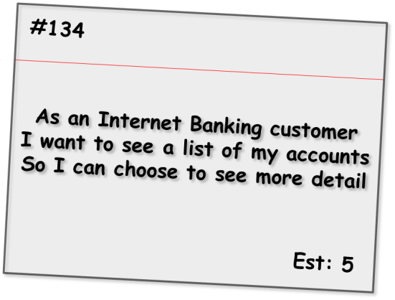
Iteration Acceptance Criteria
Given the customer has one transaction account and one credit account
When they have completed logging in
Then the screen should show the names and numbers of the two accounts sorted in account number order
Given the customer has just one transaction account
When they have completed logging in
Then the screen should show the name and number of the account
Alternate path
Given the customer has no accounts
When they have completed logging in
Then the screen should show a message stating that no accounts are available
Alternate path
Given the customer has more than 20 accounts
When they have completed logging in
Then the screen should show the first 20 accounts (in account number order) only
Bad path
Given the customer has some accounts
When they have completed logging in
And the system cannot retrieve the account details
Then the screen should show an error message with associated code and details to contact for support
Notes:
This format is iteration level acceptance criteria vs Inception level.
Shows positive, alternate and bad paths.
Talk through each one.
Low: 3min
High: 6min
-----------------------------------------------------------------------
Here we see a set of criteria for an Internet Banking story covering a range of positive, alternate and bad paths through the requirement. As is expected, the positive paths map directly to the requirements as stated and assume everything is working as expected.
The alternate path criteria describe non-standard ways to meet the desired outcome, which although may not be considered within the narrative of the story, are still reasonable to assume as usage patterns for the system.
Bad path criteria describe situations in which the outcome cannot be achieved, in this case how the system would behave in the case of an internal error.

Slide 90
Story jam continued
On the back of each user story, write acceptance criteria for that story
How will you know you are done?
Are there alternative ways to reach “done”?
Notes:
Using the stories they already wrote, have them develop acceptance criteria for some of these stories. Give them 15 minutes, meaning they will only developer acceptance criteria for a few stories.

Slide 91
Questions?
Notes:
What we’ve done……
Seen how best practices address traditional project challenges
Learned the process
Met the team

Slide 92
Estimating the Work
A Module in Agile Fundamentals
Notes:
Plan, execute and report on Agile projects
--------------------------------------------------------------------------------------------------------------------
Welcome to the module Planning the Project. This module is brought to you by ThoughtWorks Studios, maker of Mingle, Cruise, and Twist.
In this module, we’ll explore the practices that help Managers and Project Managers plan, execute, and report on Agile projects.

Slide 93
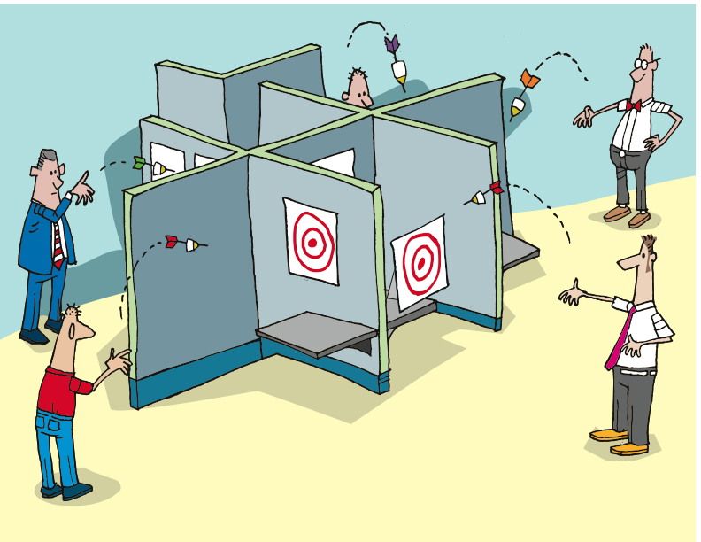
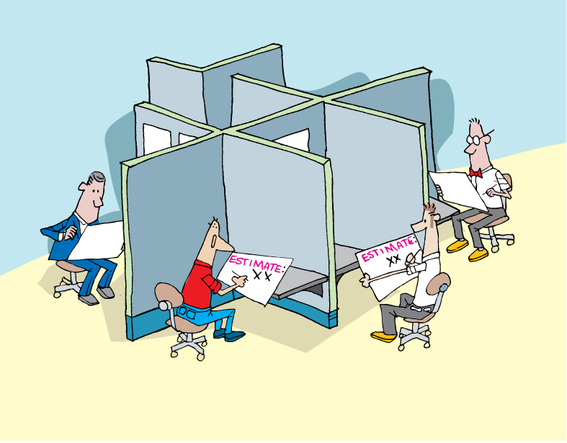
Notes:
We do not want to rely on individual estimates, certainly not from those who will not be delivering the project.
Do you do this now?

Slide 94
Estimating the Effort
Notes:
Accuracy – degree of closeness
Precision – reproducibility or repeatability
Results of calculations or measurements can be:
Accurate but not precise
Precise but not accurate
----------------------------------------------------------------------------------------------------------
Agile estimation is one of the parts that folks new to Agile struggle with. In this section, we’ll dig into the why and the how, and then give you some very specific practices.
Let’s begin with gaining an understanding of the terms “accuracy” and “precision”.
From Wikipedia, we get this definition: [CLICK]
In the fields of science, engineering, industry and statistics, accuracy is the degree of closeness of a measured or calculated quantity to its actual (true) value.
Accuracy is closely related to precision, also called reproducibility or repeatability, the degree to which further measurements or calculations show the same or similar results.
The results of calculations or a measurement can be accurate but not precise, precise but not accurate, neither, or both. A measurement system or computational method is called valid if it is both accurate and precise. The related terms are bias (non-random or directed effects caused by a factor or factors unrelated by the independent variable) and error (random variability), respectively.

Slide 95




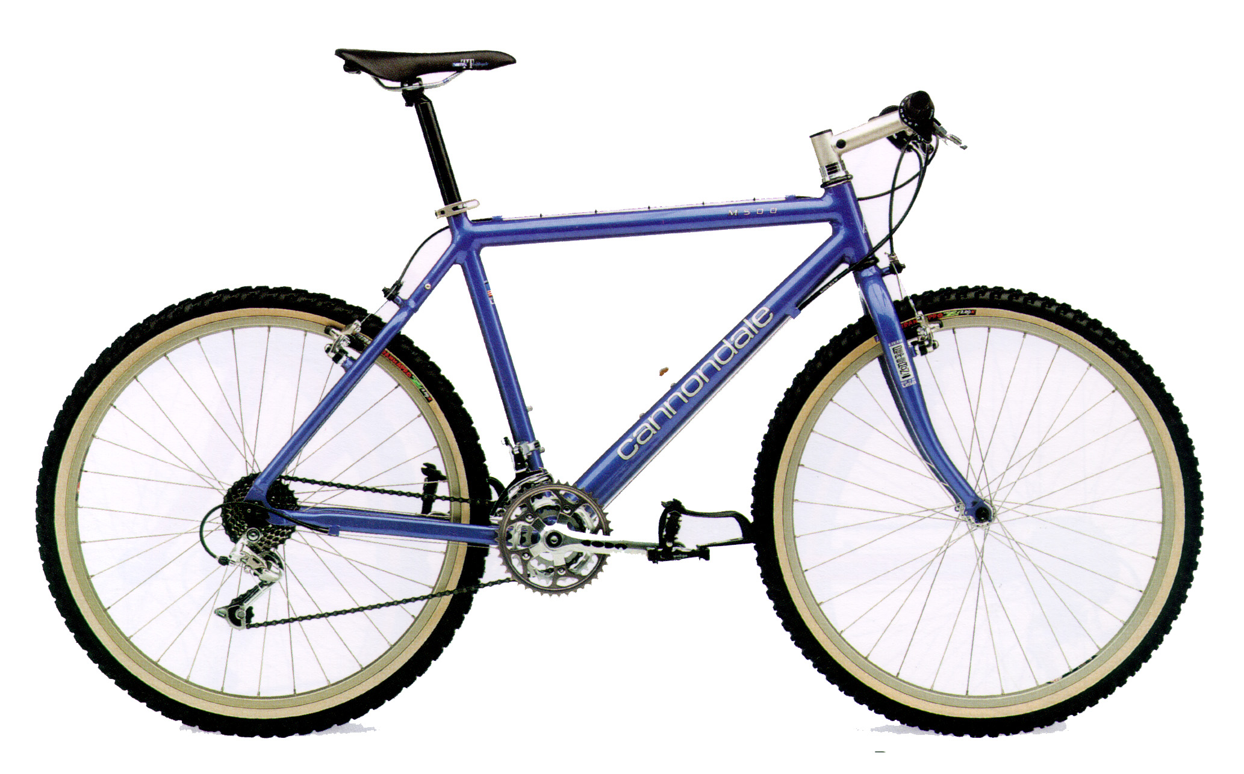
Distance to the airport from here?
Notes:
What is the distance from here to the airport?
How long does it take to get there?
Variables – traffic conditions, mode of transportation, weather – all make a huge difference in the time it takes to arrive, yet the distance remains constant.
Same with writing software – lots of things affect how long it takes to get to “done” – what are they here? (support, interruptions, meetings, etc.).
So we take a 2-part approach to agile estimating – relative size (effort, complexity) of each story, and how fast we can get work done.
We will look at relative size first.

Slide 96
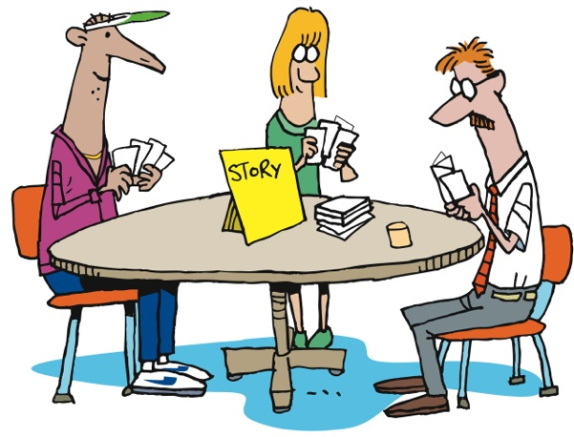
Agile Estimation: Planning Poker
Notes:
How does it work?
First the BA presents the story to the team.
Then everyone thinks about the estimate [CLICK]
Then everyone throws their estimate at the same time
No one is influenced by anyone else [CLICK]
There may be outliers [CLICK]
There is discussion about the outliers [CLICK]
Everyone re-thinks [CLICK]
Then re-throw
Sometimes necessary, sometimes not
----------------------------------------------------------------------------------------------------------------
Let’s look at how it’s done…
First, we gain a clear understanding of the story, including the acceptance criteria and the tasks needed to complete the story. Once all members of the team feel that they have that understanding, each member of the team selects the number that they feel represents the relative complexity of the story, as compared to other stories that the team has implemented.
As a group, [CLICK] team members reveal their estimates – the numbers they have chosen, that is. Revealing all at once prevents any team member from being influenced by another team member’s estimate.
It’s not unusual for there to be outliers [CLICK] – estimates that are different from the majority. When this happens, [CLICK] the team discusses the differences. Some will have thought of other tasks, or understood the tasks differently. Sometimes it’s QA who sees things differently. [CLICK]
Regardless, after discussing things, the team [CLICK] estimates again. If it takes more than three rounds of estimating, there’s a smell that needs to be addressed. The story may need to be rewritten or more analysis may need to be done.
Of course, sometimes the people who have thrown the outliers will agree to change their estimates without another round of estimating, once they understand the thinking of their teammates. In this case, no additional rounds of Planning Poker are needed for that story.

Slide 97
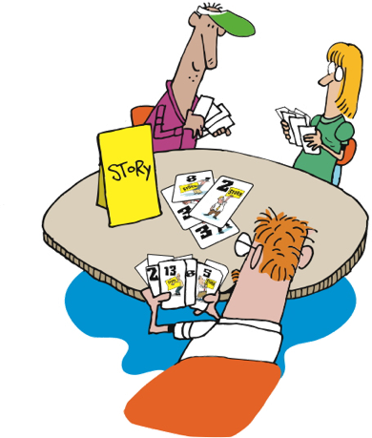
Agile Estimation: Planning Poker
Notes:
How does it work?
First the BA presents the story to the team.
Then everyone thinks about the estimate [CLICK]
Then everyone throws their estimate at the same time
No one is influenced by anyone else [CLICK]
There may be outliers [CLICK]
There is discussion about the outliers [CLICK]
Everyone re-thinks [CLICK]
Then re-throw
Sometimes necessary, sometimes not
----------------------------------------------------------------------------------------------------------------
Let’s look at how it’s done…
First, we gain a clear understanding of the story, including the acceptance criteria and the tasks needed to complete the story. Once all members of the team feel that they have that understanding, each member of the team selects the number that they feel represents the relative complexity of the story, as compared to other stories that the team has implemented.
As a group, [CLICK] team members reveal their estimates – the numbers they have chosen, that is. Revealing all at once prevents any team member from being influenced by another team member’s estimate.
It’s not unusual for there to be outliers [CLICK] – estimates that are different from the majority. When this happens, [CLICK] the team discusses the differences. Some will have thought of other tasks, or understood the tasks differently. Sometimes it’s QA who sees things differently. [CLICK]
Regardless, after discussing things, the team [CLICK] estimates again. If it takes more than three rounds of estimating, there’s a smell that needs to be addressed. The story may need to be rewritten or more analysis may need to be done.
Of course, sometimes the people who have thrown the outliers will agree to change their estimates without another round of estimating, once they understand the thinking of their teammates. In this case, no additional rounds of Planning Poker are needed for that story.

Slide 98
Agile Estimation
Discuss only if there is disagreement
If everyone agrees, then there is no need to discuss
Discuss the unknowns – “Why do you think it’s a…”
Don’t try to convince people to change
Re-throw
Notes:
This variation is one that we have used. We throw 1, 2, or 3 as valid estimates. 5 is NOT a valid estimate and means “I have no idea”. If someone throws that then we need to have a conversation.
Teams may have their own variations on this. Sometimes people can abstain by throwing “rock” (a fist).
Note: demonstrate to them the counting in strategy you will use! “One, two, three, throw!”
From Martin Fowler’s website: http://martinfowler.com/bliki/ThrownEstimate.html

Slide 99
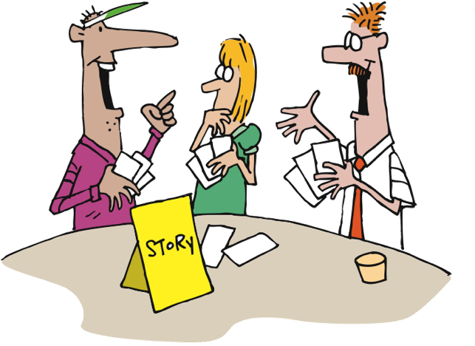
Agile Estimation: Planning Poker
Notes:
How does it work?
First the BA presents the story to the team.
Then everyone thinks about the estimate [CLICK]
Then everyone throws their estimate at the same time
No one is influenced by anyone else [CLICK]
There may be outliers [CLICK]
There is discussion about the outliers [CLICK]
Everyone re-thinks [CLICK]
Then re-throw
Sometimes necessary, sometimes not
----------------------------------------------------------------------------------------------------------------
Let’s look at how it’s done…
First, we gain a clear understanding of the story, including the acceptance criteria and the tasks needed to complete the story. Once all members of the team feel that they have that understanding, each member of the team selects the number that they feel represents the relative complexity of the story, as compared to other stories that the team has implemented.
As a group, [CLICK] team members reveal their estimates – the numbers they have chosen, that is. Revealing all at once prevents any team member from being influenced by another team member’s estimate.
It’s not unusual for there to be outliers [CLICK] – estimates that are different from the majority. When this happens, [CLICK] the team discusses the differences. Some will have thought of other tasks, or understood the tasks differently. Sometimes it’s QA who sees things differently. [CLICK]
Regardless, after discussing things, the team [CLICK] estimates again. If it takes more than three rounds of estimating, there’s a smell that needs to be addressed. The story may need to be rewritten or more analysis may need to be done.
Of course, sometimes the people who have thrown the outliers will agree to change their estimates without another round of estimating, once they understand the thinking of their teammates. In this case, no additional rounds of Planning Poker are needed for that story.

Slide 100

Agile Estimation: Planning Poker
Notes:
How does it work?
First the BA presents the story to the team.
Then everyone thinks about the estimate [CLICK]
Then everyone throws their estimate at the same time
No one is influenced by anyone else [CLICK]
There may be outliers [CLICK]
There is discussion about the outliers [CLICK]
Everyone re-thinks [CLICK]
Then re-throw
Sometimes necessary, sometimes not
----------------------------------------------------------------------------------------------------------------
Let’s look at how it’s done…
First, we gain a clear understanding of the story, including the acceptance criteria and the tasks needed to complete the story. Once all members of the team feel that they have that understanding, each member of the team selects the number that they feel represents the relative complexity of the story, as compared to other stories that the team has implemented.
As a group, [CLICK] team members reveal their estimates – the numbers they have chosen, that is. Revealing all at once prevents any team member from being influenced by another team member’s estimate.
It’s not unusual for there to be outliers [CLICK] – estimates that are different from the majority. When this happens, [CLICK] the team discusses the differences. Some will have thought of other tasks, or understood the tasks differently. Sometimes it’s QA who sees things differently. [CLICK]
Regardless, after discussing things, the team [CLICK] estimates again. If it takes more than three rounds of estimating, there’s a smell that needs to be addressed. The story may need to be rewritten or more analysis may need to be done.
Of course, sometimes the people who have thrown the outliers will agree to change their estimates without another round of estimating, once they understand the thinking of their teammates. In this case, no additional rounds of Planning Poker are needed for that story.

Slide 101
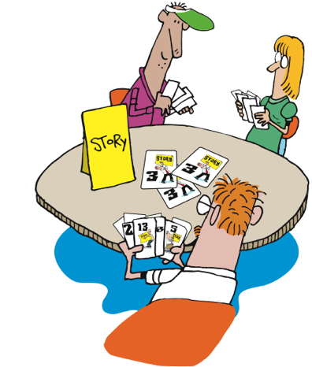
Agile Estimation: Planning Poker
Notes:
How does it work?
First the BA presents the story to the team.
Then everyone thinks about the estimate [CLICK]
Then everyone throws their estimate at the same time
No one is influenced by anyone else [CLICK]
There may be outliers [CLICK]
There is discussion about the outliers [CLICK]
Everyone re-thinks [CLICK]
Then re-throw
Sometimes necessary, sometimes not
----------------------------------------------------------------------------------------------------------------
Let’s look at how it’s done…
First, we gain a clear understanding of the story, including the acceptance criteria and the tasks needed to complete the story. Once all members of the team feel that they have that understanding, each member of the team selects the number that they feel represents the relative complexity of the story, as compared to other stories that the team has implemented.
As a group, [CLICK] team members reveal their estimates – the numbers they have chosen, that is. Revealing all at once prevents any team member from being influenced by another team member’s estimate.
It’s not unusual for there to be outliers [CLICK] – estimates that are different from the majority. When this happens, [CLICK] the team discusses the differences. Some will have thought of other tasks, or understood the tasks differently. Sometimes it’s QA who sees things differently. [CLICK]
Regardless, after discussing things, the team [CLICK] estimates again. If it takes more than three rounds of estimating, there’s a smell that needs to be addressed. The story may need to be rewritten or more analysis may need to be done.
Of course, sometimes the people who have thrown the outliers will agree to change their estimates without another round of estimating, once they understand the thinking of their teammates. In this case, no additional rounds of Planning Poker are needed for that story.

Slide 102
Agile Estimation: Planning Poker
0 + 1 = 1
1 + 1 = 2
1 + 2 = 3
2 + 3 = 5
3 + 5 = 8
5 + 8 = 13
8 + 13 = 21
Notes:
Various systems of estimates used
We use the Fibonacci Sequence
Documented by Leonardo Pisano Bogollo aka Leonardo Fibonacci
Perhaps the most talented mathematician of the middle ages
Each number is the sum of the previous 2 [CLICK]
Teams usually define what system they will use. 1,2,3,5, 8
------------------------------------------------------------------------------------------------------------------
There are various systems of estimation used, when applying Planning Poker. We use the Fibonacci Sequence numbers. The Fibonacci Sequence was documented by Leonardo Pisano Bogollo, also known as Leonardo Fibonacci, who was considered to be perhaps the most talented mathematician of the Middle Ages.
In the Fibonacci sequence, each number is the sum of the previous two numbers, starting with 0 and 1. Thus the sequence begins 0, 1, 1, 2, 3, 5, 8, 13, 21, 34
For Planning Poker, we use 0, 1, 2, 3, 5, 8, and 13. Some include 20 and 40 and 100 in our planning poker decks, in order to indicate that a story is too large to be done in a single iteration.

Slide 103




Agile Estimation: Thrown Estimates
Like “Rock Paper Scissors”
Use finger counting
Everyone “throws” their estimate after a count of 3
“One, two, three, Throw!”
Can estimate 1, 2, 3, or 5
1
2
3
?
http://martinfowler.com/bliki/ThrownEstimate.html
Notes:
This variation is one that we have used. We throw 1, 2, or 3 as valid estimates. 5 is NOT a valid estimate and means “I have no idea”. If someone throws that then we need to have a conversation.
Teams may have their own variations on this. Sometimes people can abstain by throwing “rock” (a fist).
Note: demonstrate to them the counting in strategy you will use! “One, two, three, throw!”
From Martin Fowler’s website: http://martinfowler.com/bliki/ThrownEstimate.html

Slide 104
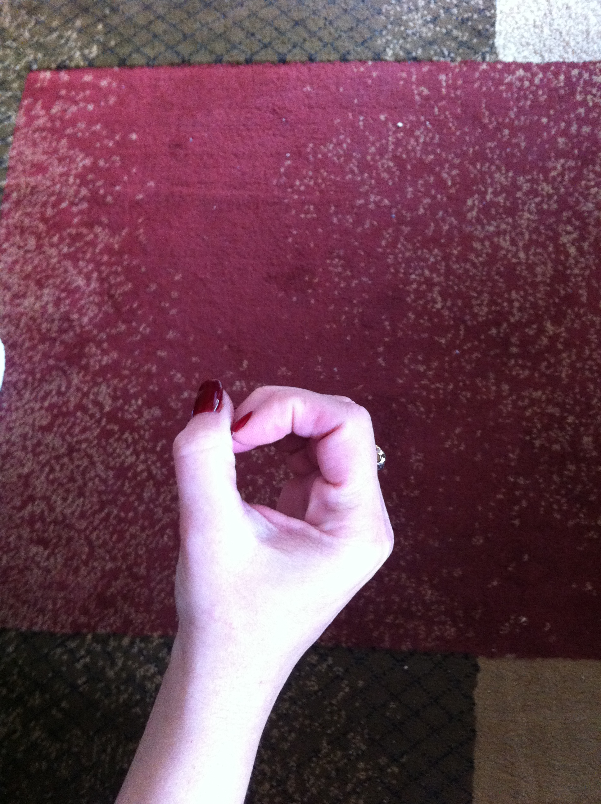
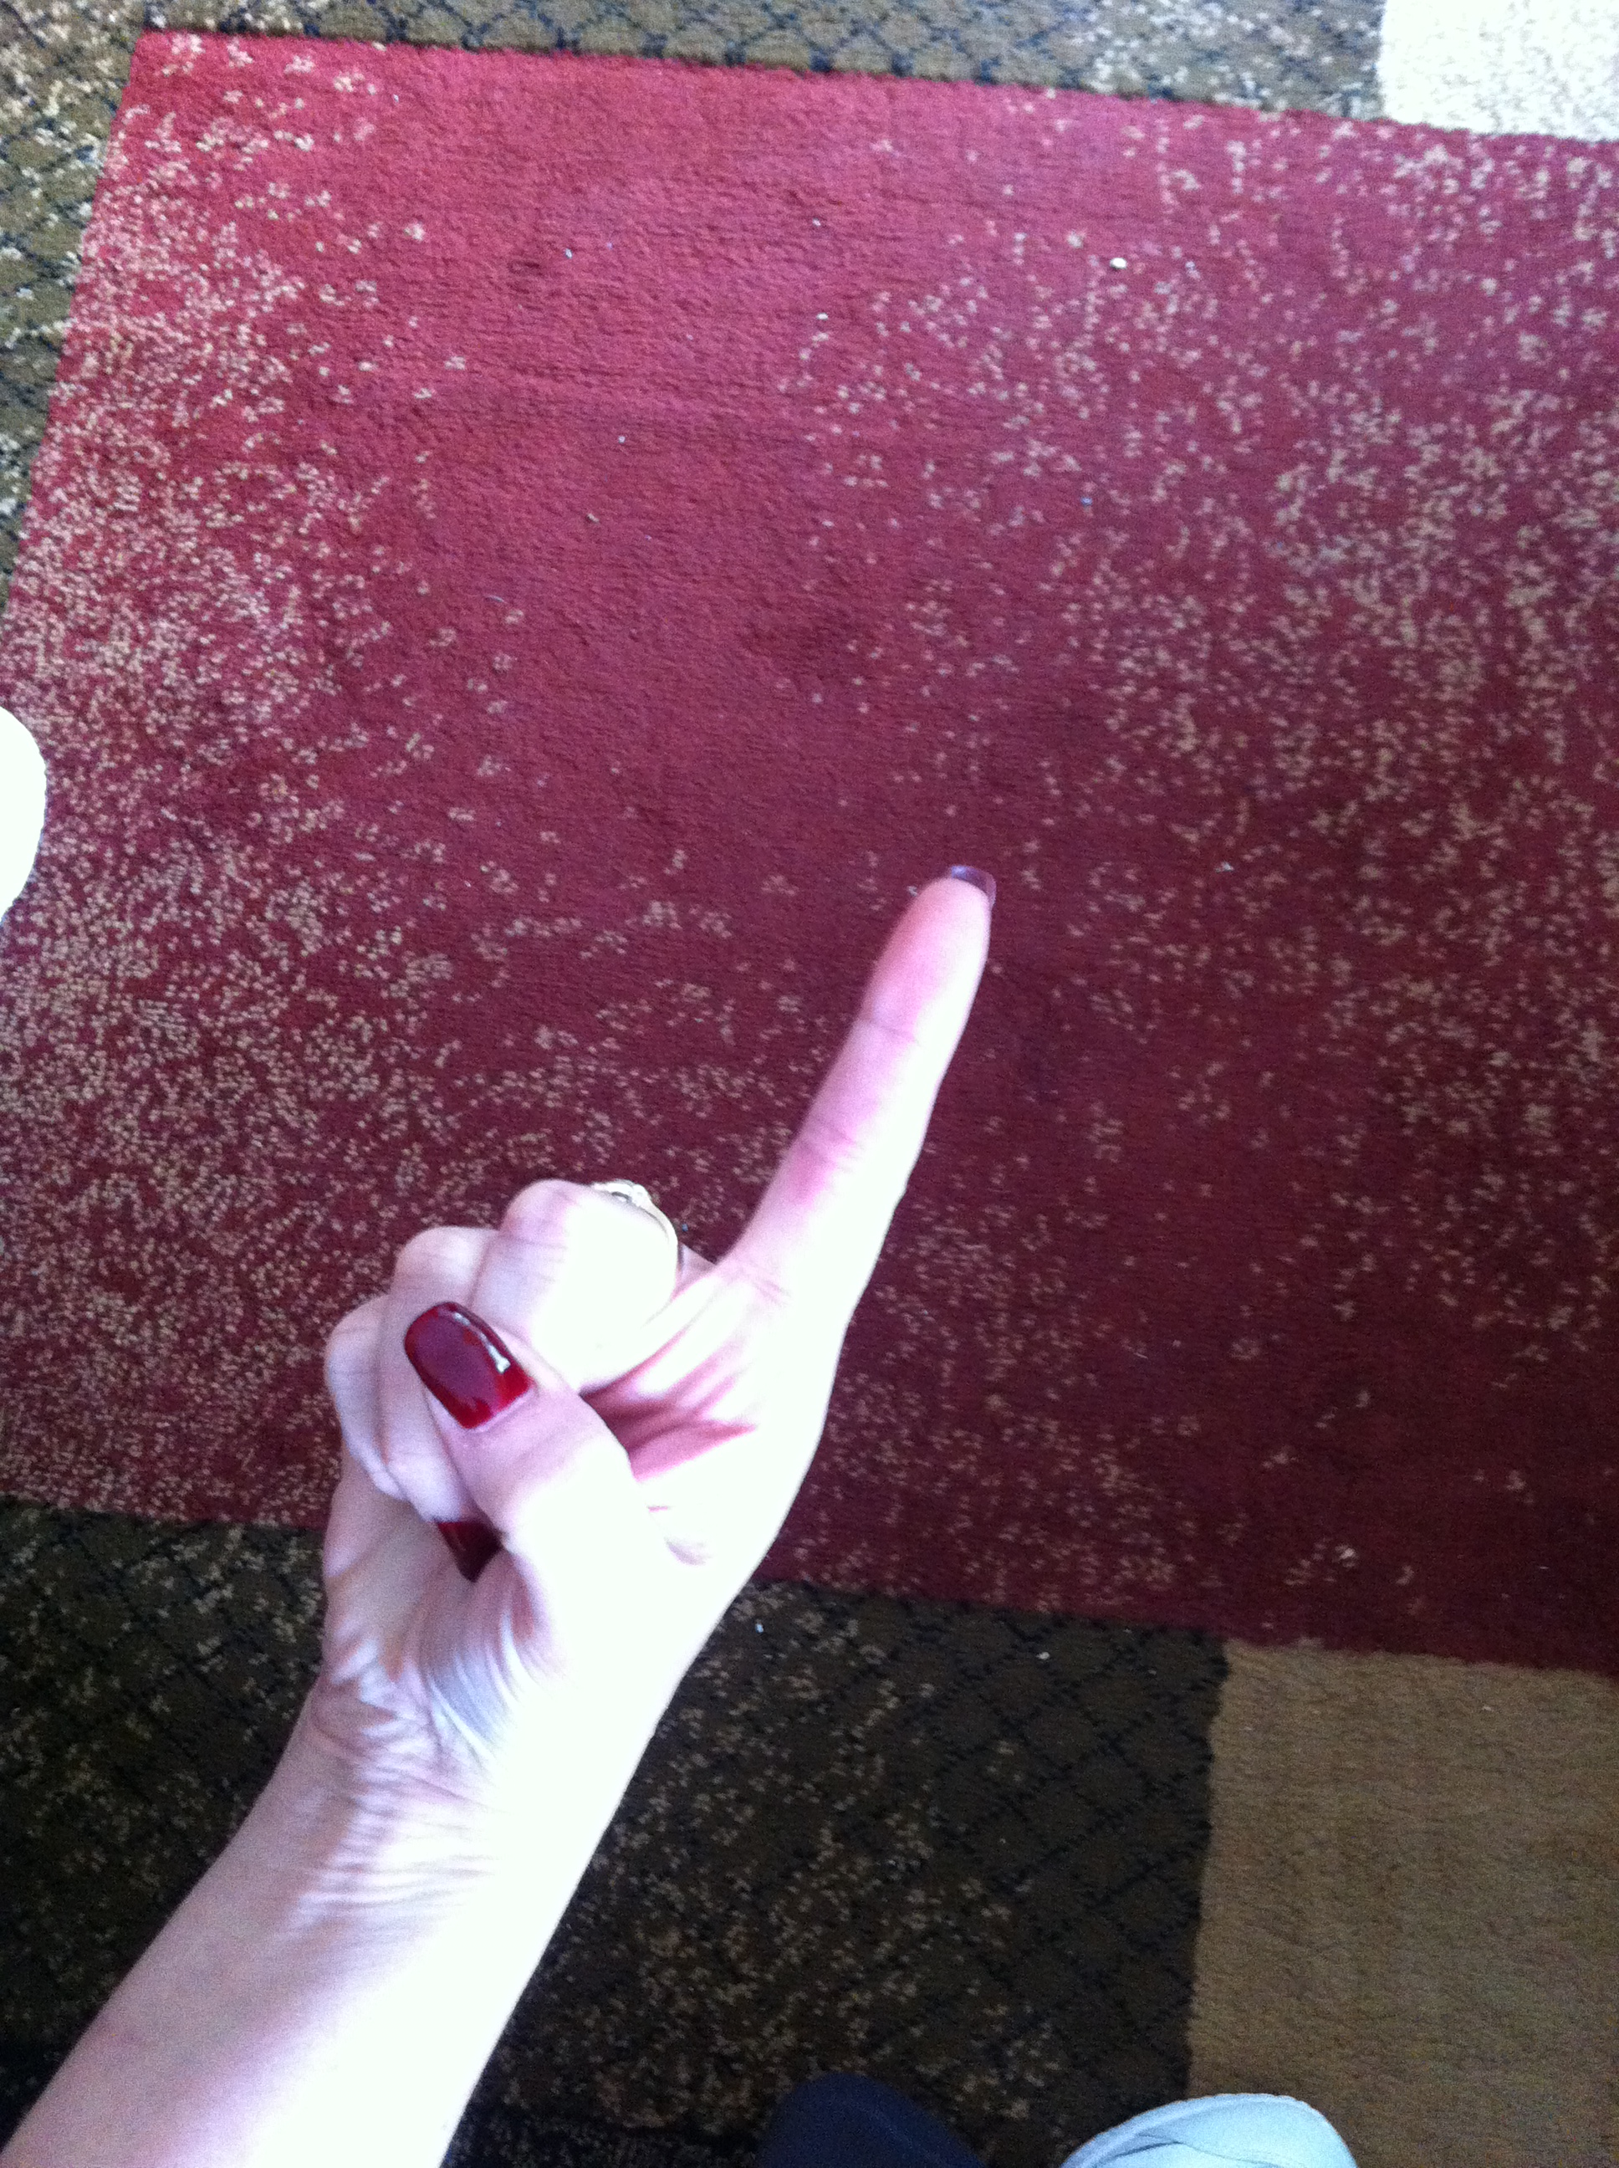





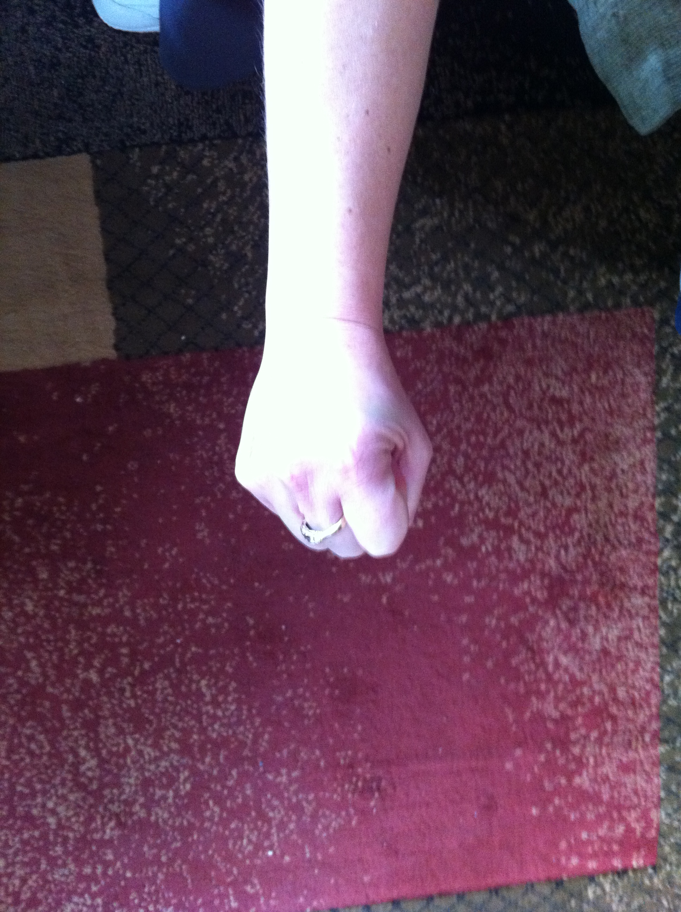
Agile Estimation: Thrown Estimates
Zero
1
2
3
5
8
10
Don’t know

Slide 105
Agile Estimation: Thrown Estimates
10 often means “too big” or “too many unknowns”
Discuss the unknowns
Individuals without much knowledge can abstain
Re-throw
Notes:
This variation is one that we have used. We throw 1, 2, or 3 as valid estimates. 5 is NOT a valid estimate and means “I have no idea”. If someone throws that then we need to have a conversation.
Teams may have their own variations on this. Sometimes people can abstain by throwing “rock” (a fist).
Note: demonstrate to them the counting in strategy you will use! “One, two, three, throw!”
From Martin Fowler’s website: http://martinfowler.com/bliki/ThrownEstimate.html

Slide 106
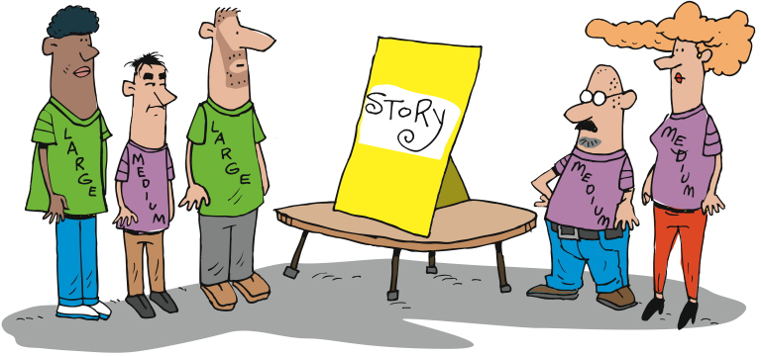
Agile Estimation: Tee Shirts
Notes:
T-shirt sizing is sometimes used as a starting point
Will need to be translated to time at some point
Helpful when thinking about a new module or initially sizing a project
----------------------------------------------------------------------
Another simple method of relative estimation is T-shirt sizing. The simplest is to estimate each story as small, medium, or large. You can include extra small, extra large, and extra extra large if you like. Any system that estimates stories relative to other stories will work.

Slide 107
Relative Sizing Tips
All stories are sized relative to another
Sort out the stories and find the smallest
Size all other stories relative to that one.
Twice as big, three times as big, etc

Slide 108
Relative Sizing Stories
Using the stories you wrote for your animal
Size the stories relative to each based on….
The effort it would take to develop this story
Note any assumptions you are making
It’s the team getting it to “done”
Notes:
About 20 minutes – great if they can estimate all their stories, but not absolutely necessary

Slide 109

Spikes
Solve hard technical problems through real experiments… without tampering with production code
Notes:
Were there any problems? Anything you didn’t know when you came to estimate?
This is where we do some more work – research – to allow us to better understand the story.
Time boxed
Throw away
Done during inception, but typically environments are set up yet
Done during Iteration 0, but initial estimate has already been given

Slide 110
How much can we do?
Notes:
Low: 1min
High: 3min

Slide 111

Velocity
Notes:
Now we need to figure out how fast we think we can work
Initially it’s a guess. Experience makes our guesses more accurate and precise.
Velocity – the amount of work that we can complete in an iteration
-----------------------------------------------------------------------------------------------------------
Once we’ve figured out how difficult each of our stories is, then we need to figure out how many we can fit into an Iteration. That’s what we call velocity – the amount of work, computed based on our estimates, that will fit in an Iteration.

Slide 112
How to Derive a Planning Velocity
Trial Iterations
Educated Guess
Experience
Velocity Planning Games
Accuracy
Effort/Time
Notes:
The line represents project start.
Educated guess using data from previous projects is risky. You must determine the variables that were in play on the other project(s) compared to this project.
Trial iteration. Costly, but most accurate for planning.
Velocity planning game. More risky. Likely to be modified.
---------------------------------------------------------------------------------------------------------------
Experienced Agile teams will set expectations for a fairly steady ramp up in velocity over time as the team forms and early uncertainties get ironed out. But the question remains – what planning velocity shall we ramp up to? As with all estimation activities, experience is an invaluable contributor but hard data is going to be the biggest factor, hence the option of using a trial iteration. As heavyweight as this sounds, taking just two weeks to provide a good set of real data for future planning over the course of a 20 week project is probably not a bad investment.
For people looking for a cheap way of obtaining a planning velocity, do be wary of using an data from previous projects, even with the same group of people. As easy as this may sound, there are so many variables unaccounted for that any planning you do is really little more than an educated guess.
Low: 1 min
High: 3 min

Slide 113
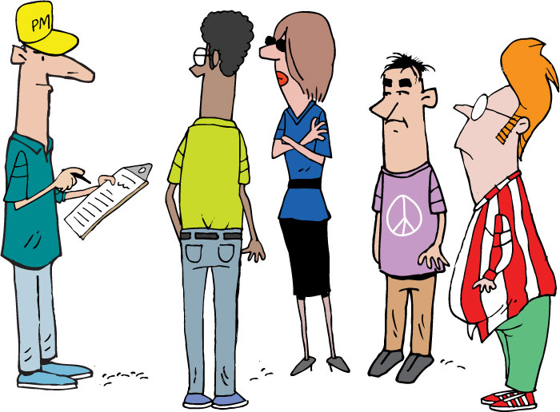
Velocity Planning Game
Devs select cards they think a pair can get “done” within an iteration
Facilitator tallies up the total (secretly)
Facilitator lays out sampling of stories
Team should decide in advance on:
Length of iteration
Definition of “done”
After a min of 10 iterations, look for convergence
Notes:
Low: 2 min
High: 4 min

Slide 114
5
3
8
1
2
2
2
3
3
5
1
8
Notes:
We take our estimated stories [CLICK]
…something we call the Raw Velocity Game.
In the Raw Velocity Game, the goal is to estimate our initial “raw” velocity, so that we can know how many stories to choose for our first Iterations.
We start with all of our stories [CLICK] and their estimates. Then we cover all the estimates [CLICK].

Slide 115
5
3
8
1
2
2
2
3
3
5
1
8
Notes:
We cover up the estimates
We take a random sample of cards and lay them out
We ask the developers which cards they feel could be done in 1 iteration
We calculate the total
We repeat
We average
The team now examines all the stories and chooses a set to answer the question “Pick a set of stories that you think you can get done in one iteration.” The idea is to pick just enough stories to fill an iteration, without overfilling it.
Once the team has picked some stories… [CLICK] pause [NEXT SLIDE]

Slide 116
3
5
8
1
2
2
2
3
Round one: 8
3
5
Round two: 11
Round three: 9
1
8
Average: 9
Notes:
We calculate the total
We repeat
We average
Gives us a starting point
Adjusted throughout the project
Assume lower velocity at the beginning of a project
Team needs to jel
Things the impact velocity
Technology
Delivery model
Team size
Full time/part time devs
----------------------------------------------------------------------------------------------------------
… we reveal the estimates [CLICK] and total them up. [CLICK]
We then repeat this process two more times, getting the team’s best guesses [CLICK], and we average all three rounds [CLICK].
The resulting number – nine in this example – gives us our initial, raw velocity. [CLICK] We’ll use this number to determine how much work we think we can get done in our first few iterations.

Slide 117
Estimate your velocity
Get back into your groups
Use the estimates you developed a few minutes ago
How many stories could you complete in a single iteration?
Notes:
Talk about iteration length here
Are we estimating for a pair, for the entire team, for a single person?

Slide 118
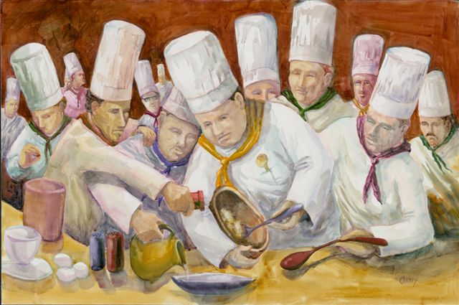
How Many Pairs?
Unfortunately this is often more art than science
But, it will probably be influenced by:
Availability
How many different feature sets/subsystems there are
How many points in the total
Gut feel – “too many cooks in the kitchen”
Notes:
Insert activity here
Without activity:
Low: 1 min
High: 3 min

Slide 119
How long?

Slide 120

How many iterations?
As a user I need to blah blah so that blah
4
2
Story Point Estimates
As a user I need to blah blah so that blah
As a user I need to blah blah so that blah
4
As a user I need to blah blah so that blah
2
Estimated Iteration Velocity
As a user I need to blah blah so that blah
1
As a user I need to blah blah so that blah
8
User Stories
(Points per iteration)
Total Story Points
/ Estimated Velocity
= Number of Iterations
Notes:
Need to answer the questions of:
How long will it take?
How much will it cost?
Other things can impact velocity, like ramp up, scheduled absences, etc, and should be factored in the plan
Low: 1 min
High: 3 min

Slide 121
Raw Velocity
Estimated Velocity Per Pair X Steady State Pairs = Raw Velocity Per Iteration
POINTS
TIME
Total Story Points / Raw Velocity Per Iteration = Rough Number of Iterations

Slide 122
How long?
Use the story estimates and estimated velocity you developed a few minutes ago
How many iterations will it take you to complete your creature?
Notes:
Talk about iteration length here
Are we estimating for a pair, for the entire team, for a single person?

Slide 123
Velocity Adjustment - Risk
Calculate with lower end of the velocity estimate, or to account for risks
POINTS
TIME

Slide 124
Velocity Adjustment – Ramp Up
Account for the team (as a steady-state whole) will take a couple of iterations to get up to full (estimated) velocity
POINTS
TIME

Slide 125
Velocity Adjustment – Onboarding
Depending on size of team, not all developers may start on the first day. May need to adjust further to match velocity to onboarding.
POINTS
TIME

Slide 126
Velocity Adjustment – Time Off
Make adjustments for known vacations, holidays, business closings, special events
POINTS
TIME

Slide 127
Development Duration Range
The intersection of the story point and velocity lines gives you your development duration range
POINTS
TIME

Slide 128
Add Non-Dev Time
Add whatever time is necessary on either end, and you have your total estimated duration range
UAT
Beta
GA
Initiation
UAT
Beta
GA
POINTS
TIME

Slide 129
Questions?

Slide 130
Release and Iteration Planning
A Module in Agile Fundamentals
Notes:
Plan, execute and report on Agile projects
--------------------------------------------------------------------------------------------------------------------
Welcome to the module Planning the Project. This module is brought to you by ThoughtWorks Studios, maker of Mingle, Cruise, and Twist.
In this module, we’ll explore the practices that help Managers and Project Managers plan, execute, and report on Agile projects.

Slide 131
Questions To Be Answered
What are you going to build?
In what order?
How long is it going to take?
How much will it cost?
What roles and how many do we need?
What else do we need to do?
Notes:
Answered the basic “how long” in Estimating section.

Slide 132
Release Success Criteria
Quantifiable business objectives
ROI
Time
Budget
Scope
Notes:
What is driving the Release?
Time, budget, scope
Market pressure for functionality
Launch of a new project
Are there quantifiable objectives / ROI that need to be met?

Slide 133
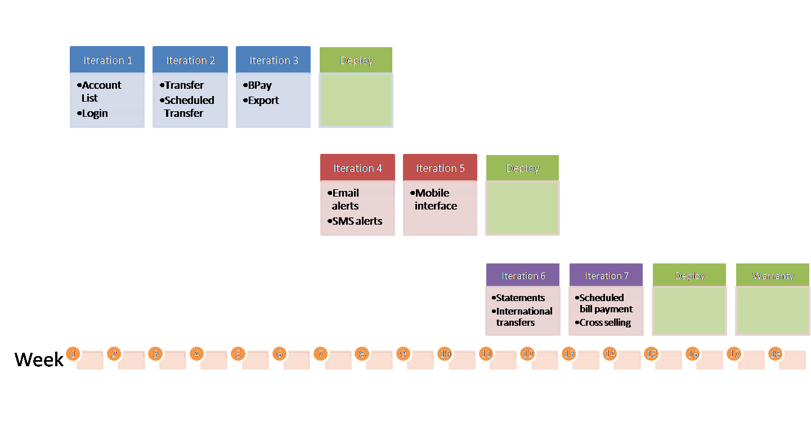
The Release Planning Inputs
Release Planning
Development Capacity (Velocity)
Release Success Criteria
Master Story List
Release Constraints
Dependencies
High level tech architecture
Cross Functional Requirements
Notes:
We need to understand the:
Release success criteria. Time driven, scope driven, $ driven.
Development capacity
Constraints - resource, technical, skill level
Project dependencies
A high level application architecture
Non functional or cross functional requirements – all the ‘abilities
----------------------------------------------------------------------------------------------------------
Like most things in an Agile world, release planning is an iterative and adaptable process. Depending on how the first cut at a release plan may look, more effort may be put into loosening the hold of external constraints (e.g., marketing schedules) or the success criteria for the release may be re-examined (e.g., perhaps another pass through MoSCoW on the story list).
Development Capacity can either be estimated (using a sampling of different story sizes and extrapolating) or determined using a spike iteration.
The success criteria for the project are probably enumerated across the lines of scope (e.g., “we must have these features at least”), cost (e.g., “we only have budget for $200 of development”) and time (“we need to get something to market before the conference starts”).
External constraints can have a big influence on the release plan and are often in the shape of project dependencies (i.e., integrating with Application X which only releases each quarter).
A release story wall can be used to show the distribution of stories between releases and between iterations within a release. Obviously a release plan is a high level artifact, so the expectation should be set to allow considerable movement at this level.
Low: 2 min
High: 5 min

Slide 134
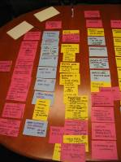
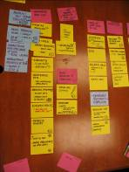
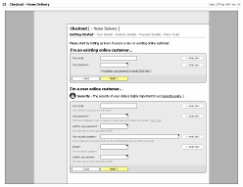
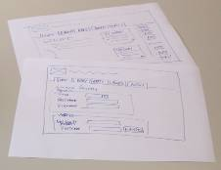
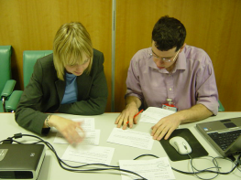
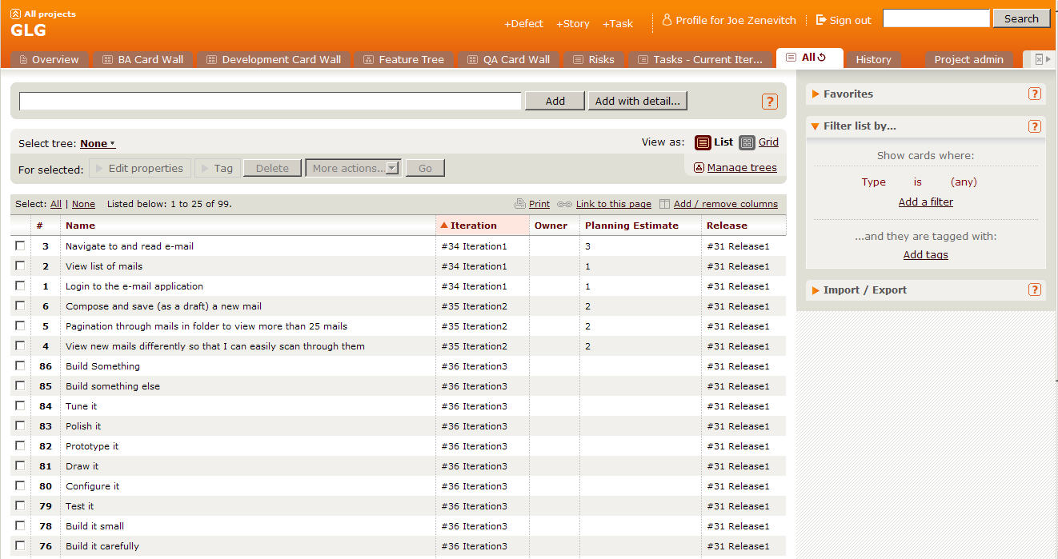
Initial Story List
As-Is & To-Be Process modelling
Low fidelity prototyping
Focused small group analysis
Initial story list
Notes:
The story is the unit of work we will measure to determine approximate length and cost of project.
We conduct many workshops to create stories and ultimately the MSL.
We go in depth on each of these items and more to get to our initial story list.
We should have done all of this already in the previous sections.
Low: .5 min
High: 2 min

Slide 135

Prioritize the stories

Slide 136
MoSCoW Prioritization
Won’t Have
Could Have
POINTS
Should Have
Must Have
Notes:
Most likely the total bucket of stories will can be categorized into these four buckets. For the purposes of planning the first release, the MMR should be the Must Have bucket.

Slide 137
Span Planning
Goal
Goal
Goal
Activity
Activity
Activity
Activity
Time
Story
Story
Story
Story
Necessity
Story
Story
Story
Story
MMF
Story
Story
Story
Story
Story
Story
Notes:
There are many versions of this approach, but in essence its about laying out the stories so that you can see where the MMF is.
The next slide shows an example from Jeff Patton
When prioritizing stories and building the Release Plan, consider the following:
Business Value – does this contribute to the ROI. What is the Minimum Marketable Feature set?
Risk – does the item carry either technical or functional risk
Usage – How often is this feature set used and by how many different roles/personas?
Compliance – is the feature set required to avoid possible financial penalties?
Dependencies - is this feature set dependent on or required by another team?
Simplicity – do we need all parts/stories for this feature set? Or can we go Live with a subset?

Slide 138
Prioritize Your Stories
Get back into your groups
Sort your stories into priority order
What is the MMF set of stories
Can you do them all?
Notes:
Prioritize stories into Minimum Marketable Features (MMF)

Slide 139



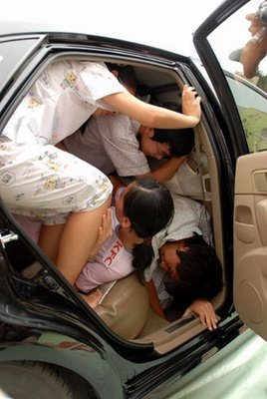

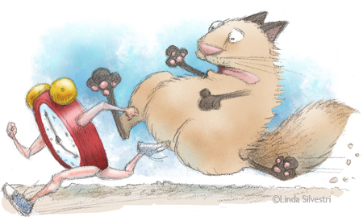
What Are Your Constraints?
Quality?
Scope?
Resources?
Budget?
Time?
Scheduling?
Notes:
Unconstrained Model
Tell us how long it will take to build this
Constrained Models
Tell us what we can build and stay within budget
Tell us how long it will take to build this with the staff we have
What can we get built in a certain timeframe
A time constrained project is one where the first release must be delivered by a certain date
A resource constrained project is where for whatever reason you can’t add more people, which could be because there is a budget constraint
But, budget could also be a constraint on how long the team can work for
A scope constraint is where a certain scope must be delivered for some reason (perhaps compliance reasons)
Low: 2 min
High: 5 min

Slide 140
Dependencies
Cross project dependencies
Departmental dependencies
Staffing dependencies

Slide 141
Cross-Functional Requirements
Execution
Evolution
Auditability
Authentication
Authorization
Availability
Performance
Regulatory
Security
Portability
Extensibility
Localization
Scalability
Usability
Notes:
Another type of requirement that has to be captured on all projects is the NFR.
We all know what these are. They creep up on us near the end.
Execution qualities of a system – security, usability
Evolution qualities – testability, extensibility, scalability
NFRs are typically technical or usage based and usually follow policy or documented guidelines
Make them cards.
Its work you have to do.
HAVE SOME DISCUSSION HERE as to what you can do about these.
Technique-
Send out a questionnaire first for folks to do their homework.
How many transactions/users/countries/whatever?
Response time?
What platforms?
Compliance
Low: 5min
High: 15min

Slide 142
In Summary
Prioritizing stories
Minimally Marketable Features
Span Planning
Other activities

Slide 143
What goes into each release?
The rest – 520 pts
MMF = 1,297pts
Priority 2 – 873 pts

Slide 144
Iteration slotting
Notes:
Put the stories into iterations, with the total points in each iteration totaling the estimated velocity (earlier calculation).
Should be some sense of a theme in each iteration (get sign-on working, deliver reports, credit card payment, etc.), along with a prioritization of business value.
Deliver high value first.

Slide 145
Iteration Planning
Using the iteration length you decided upon earlier.
Use your stories, their estimates, estimated velocity, and prioritization
Arrange the stories in priority order in iterations
Notes:
Develop 3 or 4 iterations.
This conversation may lead to “how long is an iteration” – for the animal, each iteration is 4 minutes

Slide 146
Questions?

Slide 147
Visibility and Communication
A Module in Agile Fundamentals
Notes:
Plan, execute and report on Agile projects
--------------------------------------------------------------------------------------------------------------------
Welcome to the module Planning the Project. This module is brought to you by ThoughtWorks Studios, maker of Mingle, Cruise, and Twist.
In this module, we’ll explore the practices that help Managers and Project Managers plan, execute, and report on Agile projects.

Slide 148




Four Key Agile Meetings
Iteration Planning
Showcase
Stand Ups
Retrospectives
Notes:
3 of these meetings can be done distributedly.
We discourage distributed Release Planning.
Mountain goat software has distributed Planning Poker.
Ideaboardz and Edistorm are good for distributed Retrospectives.

Slide 149

Daily Stand-Up
Notes:
Daily Scrum or daily standup
Chickens and pigs – who talks, who doesn’t
Held daily
Entire team
Answer 3 questions
What did you do yesterday?
What are you going to do today?
What obstacles or impediments are preventing you from making progress?
Short
Conducted by the card wall
Everyone stands
Keeps everyone informed
Not a status meeting
--------------------------------------------------------------------------------------------------------------
Whether you talk about Scrum – and call them daily scrums – or XP – and call them daily stand-ups – the concept is common to both systems. The idea is that the project team gets together daily, stands up, and each committed member of the team (the pigs) shares the answers to these three questions:
What did you do yesterday?
What are you going to do today?
What obstacles or impediments are preventing you from making progress?
Generally speaking, these meetings should be pretty short. Team members will frequently refer to stories by number or title, like “I completed number 421 yesterday and am going to start on number 437 today. I can’t get going until the database is set up.”
Since the card wall - whether physical or electronic - is readily available and visible, generally it’s easy for everyone to understand what is being discussed.
The meetings are held standing, because the goal is to keep them short. Anything that doesn’t fit easily into the answer to one of the questions is recorded and discussed at the end of the stand-up meeting. Chickens are generally not permitted to speak during stand-up, as what they have to say may be important and valuable, but is not a part of this particular meeting.
The daily stand-up, or daily scrum, contributes significantly to keeping all parties informed about what’s going on and what progress is being made.
The daily stand-up is not a status meeting. It is not an opportunity for everyone present to report to the project manager, scrum master, or anyone else. The daily stand-up is a chance for everyone to keep up to date with what is going on on the project.

Slide 150
Team Room: Open Conversations
Notes:
If you are a small team, working in a team room, and pairing, you may not need daily stand-ups, but this is a very rare occurrence

Slide 151

Showcases
Notes:
Goal - Working software at the end of each iteration
Showcase at the end of each iteration
Not design session or brainstorming
We do get feedback
Feedback may turn into new stories
For the chickens
-------------------------------------------------------------------------------------------------
With the goal of ensuring that information and knowledge are spread throughout team and stakeholders, and that the team gets valuable feedback as early as possible, we follow each Iteration with a showcase.
During the showcase, we show what has been done during the Iteration just completed. This is not a design session, nor a brainstorming session. The purpose of the showcase is to say “here’s what we’ve gotten done” and to solicit input from the participants. It is not unusual for additional stories to be generated as a result of the showcase, as stakeholders gain a greater understanding of what is actually being delivered and the value that goes with that.
This is not to say that we don’t share what we’re doing prior to the showcase. It’s that the showcase is the time when we say “this is what we’ve gotten done” and actively seek feedback from stakeholders who are not normally involved on a daily basis – the Chickens.

Slide 152

Retrospectives
“Whether you are using Agile methods or more traditional incremental or iterative development, your team has an opportunity to reflect at the end of every increment and identify changes and improvements that will increase the quality of the product and the work life of team members.”
Esther Derby and Diana Larsen
“…a well-run retrospective can help members of a community understand the need for improvement, and motivate them to change how they go about their work.”
Norm Kerth
http://www.thekua.com/rant/wp-content/uploads/2006/03/StarTechnique.gif
Notes:
Rodin, the artist, said
“Nothing is a waste of time if you use the experience wisely.”
Oscar Wilde said
“Experience is the name everyone gives to his mistakes.”
[CLICK]
Norm Kerth – 2000 – ‘Project Retrospective’ [CLICK]
Esther Derby and Diana Larsen – 2006 - wrote the book “Agile Retrospectives: Making Good Teams Great”.
[CLICK]
At the end of each Iteration, Release
Starfish model – Patrick Kua – TW
Review the model
Action items
Reduce waste, constant improvements
What’s the purpose of having a retrospective? It should be:
Informative – Communicate “the story” to all
Enlightening – Capture data, metrics or collective wisdom gained from the project
Progressive – Improve process/management/culture
Cathartic – Repair damage to the team or allow the team to enjoy what’s been accomplished
-----------------------------------------------------------------------------------------------------------
Rodin, the artist, said “Nothing is a waste of time if you use the experience wisely.”
Oscar Wilde said “Experience is the name everyone gives to his mistakes.”
And Kierkegaard said “Life can only be understood backward, but it must be lived forward.”
In 2001, Norm Kerth wrote the book “Project Retrospectives,” in which he said [CLICK] “a well-run retrospective can help members of a community understand the need for improvement, and motivate them to change how they go about their work.”
Following in Kerth’s footsteps, in 2006 Esther Derby and Diana Larsen wrote the book “Agile Retrospectives: Making Good Teams Great”. In their book, Esther and Diana said [CLICK] “Whether you are using Agile methods or more traditional incremental or iterative development, your team has an opportunity to reflect at the end of every increment and identify changes and improvements that will increase the quality of the product and the work life of team members.”
[CLICK] Agile teams generally include retrospectives as one of their practices. While different teams make different choices, it’s most common for teams to do retrospectives at each milestone – that is, at the end of each Iteration, Release, and at the end of the Project. We recommend Derby and Larsen’s book “Agile Retrospectives” as a key component of your team’s library. The activities and guidance in this book are priceless.
The goals of retrospectives, as stated by Kerth and Derby and Larsen, are to use the past – our experience – to improve our future. Whether it’s team functioning and communication – focused on the people – or technology, architecture, and technical practices, the goals are the same – learn and improve.

Slide 153
Maintaining Visibility and Communications
Notes:
Accurate visibility into project progress has traditionally been a problem
Agile address this by making project status extremely visible to everyone
----------------------------------------------------------------------------------------------------------------
One of the exciting and powerful aspects of Agile is the free flow of information and communication. This is true both within an Agile team, and between the team and the rest of the organization. Agile teams talk about transparency, meaning that facts and information are freely available at all times, and that our successes and failures are equally visible.

Slide 154

Information Radiators
Notes:
Static sources of information available to anyone who chooses to view them.
No request needed
Always updated and ready to view [CLICK]
Standard ones [CLICK]
Custom ones
----------------------------------------------------------------------------------------------------
One of the tools for this communication and transparency is a category of things that we refer to as “information radiators”.
[CLICK]
Information radiators are static sources of information that are available to anyone who chooses to view them. By “static” we mean that there is no request needed and no specific interaction (although we’ll get back to this when we talk about Mingle). Rather, information radiators provide information simply by viewing them. Examples [CLICK] are the card wall and the burn-up chart which we touched on briefly a bit earlier in this module. The card wall is always there, and anyone can look at it and learn the state of the project, release, or iteration.

Slide 155

The Card Wall
Notes:
Card wall is in the team room
Easily accessible and visible
Mingle example [CLICK]
Not methodology dependent – scrum, lean, xp
Single iteration
Showing state of the card [CLICK] Ready for Analysis to Deployed
Some cards in next iteration – Analysts typically work iterations ahead of development
Clearly see the status of the iteration [CLICK] [CLICK]
--------------------------------------------------------------------------------------------------------
We’ve talked about the card wall throughout this course. Let’s look at it again, and an example of a card wall in Mingle.
[CLICK] It’s hard to overstate the value of the card wall. Regardless of the approach you follow – Scrum, XP, or Lean, for example – there is a card wall, and the value of it lies in its ability to communicate so clearly and completely, requiring little effort on the part of the reader.
Here’s an example of a representation of a card wall in Mingle. As you can see, this card wall is focused on a single Iteration, covering states [CLICK] from Ready for Analysis to Deployed. In many cases, the stories in the Ready for Analysis and In Analysis states are actually being prepared for the next Iteration. The work of Business Analysts is generally an Iteration ahead of the rest of the team, allowing them the time they need to figure out details and acceptance criteria so that the stories will be ready for the development team.
As you can see here, it’s easy to understand the state of the work being done in an Iteration on the card wall. For instance,[CLICK] we can see that there are a number of stories on which the work is complete that are waiting to be deployed. At the other end, [CLICK] there are a couple of stories that are ready for development, [CLICK] a few in development, and so on. Without even looking at the specific stories, [CLICK] we can learn a great deal about the project just by seeing the flow of work through viewing the card wall.

Slide 156
The Card Wall
Develop the outline of your card wall
Put the cards for iteration 1 onto the wall
Notes:
Prioritize stories into Minimum Marketable Features (MMF)

Slide 157

Daily Stand-Up
Notes:
Daily standup is important to visibility and communications
Communication flow is daily at a minimum
Minimal lags in work
Chickens can learn about day-to-day by attending
------------------------------------------------------------------------------------------------------------------
While we’ve talked about it before, it’s important to come back to Daily Stand-Ups again in the context of Visibility and Communications.
There are a number of goals accomplished by holding daily stand-ups.
Doing them daily means that the communication flow is consistent. It also means that there are minimal lags – we all know what we’re all doing very immediately, without having to wait for status reports. It also means that others – managers, stakeholders – can learn about what’s going on day-by-day by attending a daily standup. That assumes that the team gives permission for others to attend, of course.

Slide 158

Reporting Progress – Burn Down
Notes:
2 primary radiators – Burn up and burn down
Comes directly from SCRUM
Same info in slightly different format
What we have to do [CLICK]
And when we are done [CLICK]
Release and/or iteration level charts
---------------------------------------------------------------------------------------------------
There are two primary reports that are used by Agile teams: the Burn Down chart, and the Burn Up Chart. The Burn Down chart comes directly from Scrum. Both charts represent the same information, fundamentally, but in a slightly different presentation.
The Burn Down chart approach is to start with the assumption that we know how much work we have to do [CLICK], and that we know we’re done when there’s nothing left to do [CLICK]. This is used for release level reporting, and is based on the practice of identifying all stories to be done during this release, and assuming that there will be no changes. While it is adaptable, and can accommodate changes in scope, it is not as clear, in our estimation, as…

Slide 159

Project Burn-Up
Scope
Velocity
Notes:
Burn-Up Chart
Primarily discussion, with an example of a burn-up chart

Slide 160
Release Burndown
Develop an outline of a release burnupchart
What is the total number of points in your MMF?
How many iterations do you think you need?
Notes:
Prioritize stories into Minimum Marketable Features (MMF)

Slide 161
Questions?

Slide 162
Agile Engineering Practices
A Module in Agile Fundamentals
Notes:
Welcome to Agile Development Practices, a module in Agile Fundamentals. This module is brought to you by ThoughtWorks Studios, makers of Cruise, Twist, and Mingle.
In this module, we’ll explore the practices that ThoughtWorks considers the essential elements of Agile Development Team practices.

Slide 163

Introduction
Notes:
Software Craftsmanship movement
Requires certain skills and disciplines to do it well
Agile has some best practices as well
--------------------------------------------------------------------------
Some of you may have heard of the Software Craftsmanship movement. Whether you believe that software development is a craft, a profession, an art, or magic, what’s important to think about is that in most cases, software development – like any skilled activity – requires certain disciplines and skills to do it well.
In the Agile world, there are a number of practices that have become best practices, as they are likely to contribute to successfully building, deploying, and maintaining software.
Let’s begin with one of the hardest for most developers to adopt: test-driven development, or TDD.

Slide 164
What We Will Cover
Unit Testing and Test Driven Development
Pairing
Smells
Refactoring
Generalization and Specialization
Continuous Integration

Slide 165
Unit Testing
Notes:
We’ll begin by looking at a little project in the Waterfall way, and see the results of doing it the “traditional” way.
And for those of you who have been through the first two modules, this one is a little bit different…

Slide 166
Unit Test
“A Unit Test is a procedure used to validate that individual units of functional code are working properly. “
Is usually done by developers
Improves quality
Facilitates changes
Simplifies integration
Enables automation
Provides effective system documentation
Makes your life simpler
Notes:
Read the definition.
Is usually done by developers
Improves quality
Facilitates changes
Simplifies integration
Enables automation
Provides effective system documentation.
Makes your life simpler
Assures that you have build the thing right (not necessarily the right thing)

Slide 167
Unit Testing The Agile Way: Test First
Notes:
Now, let’s consider how we’d proceed in an Agile world, considering Test-Driven Development. The key aspect of Test-Driven Development is that the test is created BEFORE the development work is done, hence the name “test first” or “test-driven development”.

Slide 168
Test Driven Development
“Test-Driven Development (TDD) is an evolutionary approach to development which instructs you to have test-first development intent. Basically, you start by writing a test and then you code to elegantly fulfill the test requirements.”
Small successful, tested steps.
Do the simplest thing that could possibly work.
Notes:
Read the slide.
Small successful, tested steps.
Do the simplest thing that could possibly work.

Slide 169


A User Story
Notes:
Hero is walking and stubs his toe.
Has an idea of somehow protecting his feet.
Comes up with a story - “As a walker, I want my feet protected from loose stones, so that I will have fewer bruises on my feet.”
---------------------------------------------------------------------------------------------------------------------
One day, our hero is walking along and stubs his toe on a rock. He identifies a need – he needs to stop stubbing his toes!
The need leads to an idea – the idea of covering his feet somehow, so he won’t stub his toes any more.
In our last module, we talked about user stories a bit. In this case, the story might be something like “As a walker, I want my feet protected from loose stones, so that I will have fewer bruises on my feet.”

Slide 170

Test First
Notes:
1st the hero writes a test. When I walk on stones, my feet don’t hurt.”
He executes the test.
The test fails.
-----------------------------------------------------------------------------------------------
Unlike in our waterfall version, the first thing our hero does is to write the test.
His test says “When I walk on stones, my feet don’t hurt.”
Then he executes the test.
The results? OW! ☺
So here we have a very specific test that addresses a very specific need, and determines what will be developed.

Slide 171

Notes:
Hero develops to get the test to pass.
Most simple design to get the test to pass. Walk on stones without hurting his feet.
Doesn’t address HOW. Just the result.
Develops to the result.
-----------------------------------------------------------------------------------------
During development, our hero has only one goal in mind – to get the test to pass.
That’s it. He wants to make that one, simpler, clear test pass.
So all he needs is something that will allow him to walk on stones without getting his feet hurt.
Notice that the test does not say HOW to pass. It just says what the results must be.
Off he goes, doing development with the intent of getting the test to pass.

Slide 172

Notes:
Now the test passes.
And the test is part of the build process. Constantly rerunning the test every time a build is run.
----------------------------------------------------------------
And pass it does! Yes, it’s that simple. At least so far.
Determine what it is you are going to create by writing a test, then develop something that passes the test. It shouldn’t do anything more than it needs to to pass that test, however.
And that’s what our hero has here.
Of course, while the test has passed, he looks at what he’s done and realizes that it’s not ideal. It’s not even particularly good. It works, but what if…

Slide 173

Notes:
A new requirement is received.
Protect my feet from falling objects.
New code is added to accommodate this requirement.
Again, write the test first.
Commit to unit testing by writing the test first
Restrict development to only that to pass the test. And any existing tests.
Know exactly when we are done.
--------------------------------------------------------------------------------------------------------------------------------------------
We do it again. We identify another requirement, which we represent with another test. This will lead us to doing more development, reviewing what we’ve got, and maybe doing some refactoring.
What’s important in all of this, however, is that we start with the test. There are several different points of value in this:
We commit to unit testing everything we do, because we write the test first.
We restrict ourselves to writing only the code we need to satisfy the test, and any existing tests. This keeps our code clean, because we’re not adding stuff that “we might need later.” We don’t consider later, we only consider the now.
Because we start with the test, we know when we’re done – the test has passed! There’s no question about it, since it’s simple and clear.
First, write the test. Then, write the code. When the test passes, you’re done.

Slide 174
Uncle Bob Martin’s Three Laws of TDD
You are not allowed to write any production code unless it is to make a failing unit test pass.
You are not allowed to write any more of a unit test than is sufficient to fail; and compilation failures are failures.
You are not allowed to write any more production code than is sufficient to pass the one failing unit test.
Notes:
What are the benefits of doing TDD?
All code is testable by definition!
In order to test any module in isolation you must decouple it, so TDD forces you to decouple modules.
This forces you to make better designs.
The Law of Diminishing Returns
This is why many actually consider TDD to be a DESIGN practice and not a Development Practice.
“When you follow the three rules of TDD, all your code will be testable by definition! And another word for "testable" is "decoupled". In order to test a module in isolation, you must decouple it. So TDD forces you to decouple modules. Indeed, if you follow the three rules, you will find yourself doing much more decoupling than you may be used to. This forces you to create better, less coupled, designs”
http://butunclebob.com/ArticleS.UncleBob.TheThreeRulesOfTdd

Slide 175
Pairing
Notes:
Let’s start with something fun: Common arguments against pair programming….

Slide 176
Pairing
Why it sucks, and why you should hate it

Slide 177
It’s distracting!
Hard to focus on the problem at hand when your pair is sitting next to you talking

Slide 178
Costly
Two people doing the work of one

Slide 179
Low morale
Only spend 50% of your time doing any actual work

Slide 180
Hygiene
What?! I have to shower every day?!

Slide 181
Stop slowing me down!
Explaining thoughts to my pair will slow me down

Slide 182
Pair Programming
Now let’s talk about the reasons you should do it

Slide 183
Development The Waterfall Way
Notes:
Now that we’ve talked about Test-Driven Development, it’s time to talk about Development. That is, the work you do to pass tests and deliver value.
First, of course, we’ll look at the Waterfall way.

Slide 184

Pairing 1
Notes:
We sit down, confident of our ability.
We read the instructions, follow them carefully.
At some point we realize we’ve put widget A into slot 1 as we were told, but we put it in BACKWARDS.
Take it apart to reverse widget A
Let’s consider the classic approach. For those of you who are parents, or who have ever bought anything that says that dreaded phrase “some assembly required” – this example is for you!
Most of us have had the same kinds of experiences. We sit down, confident of our ability to put the thing together. We read the instructions, and we follow them very, very carefully. And, at some point, we realize that we’ve put widget A into slot B, just as we were supposed to, but we put it in BACKWARDS! And now we have to take the thing apart far enough to reverse widget A. And then we get to put it all together again. Sigh.

Slide 185

Pairing 2
Notes:
Or we get to the end, but it just doesn’t look right.
How can we avoid this?
-----------------------------------------------------------------------------------------------------------------
Or we get all the way to the end, only to find that we’ve somehow managed to put it all together, but it doesn’t look anything like the picture.
Why does this happen? How can we avoid it?
Maybe…

Slide 186
The Agile Way: Pairing
Notes:
In the module The Origins of Agile Software Development, we talked about Kent Beck and how he came up with Extreme Programming. At that time, we mentioned pairing. Let’s look at pairing in a little more detail now.
Here’s a definition:
“Pair programming is a software development technique in which two programmers work together at one work station. One types in code while the other reviews each line of code as it's typed in. The person typing is called the driver. The person reviewing the code is called the observer or navigator. The two programmers switch roles periodically.
“While reviewing, the observer also considers the strategic direction of the work, coming up with ideas for improvements and likely future problems to address. This frees the driver to focus all of his or her attention on the "tactical" aspects of completing the current task, using the observer as a safety net and guide.”
http://en.wikipedia.org/wiki/Pair_programming
Two of everything is better than one – minds, (pairs of) hands, (pairs of) eyes.
Let’s see why…

Slide 187

Pairing 3
Notes:
We believe that having 2 people working together produces better results.
Better means…
Fewer defects
Less rework
More creativity
Easier to maintain
Sitting side by side
Working on one piece of code
One is the driver – hands on the keyboard and mouse
Two is navigating, doing code review, asking questions, maybe doing research
Change roles periodically
Instead of being distracting, it turns out to be helpful, useful
-----------------------------------------------------------------------------------------------
Unlike in our classical approach, in Agile we believe that having two people working together produces better results. That is, by “better” we mean that there will be fewer defects, less rework, more creativity, and the results will be easier to maintain.
So in actual practice, pairing would say that there are two people sitting side by side, working on one piece of code together. One – as it said in the definition – is the driver, with hands on keyboard and mouse. The other will be navigating – doing real-time code review, asking questions, maybe doing a little research on the side. They will be bouncing ideas off each other. They will change roles periodically.

Slide 188

Pairing 4
Notes:
By switching roles,
they stay fresh,
check each other’s work and
get done faster
Instead of low morale, you get collaboration, quality and camaraderie
Let’s talk about quality
2 heads are better than 1 – solution is likely to be better
Will see the problem AS IT HAPPENS. If they are paying attention.
--------------------------------------------------------------------------------------------------------------------------
The driver becomes the navigator and the navigator becomes the driver. Between the two of them, they manage to stay reasonably fresh, to check each other’s work, and to get done faster.
Yes, faster.
But let’s get back to fewer defects. We’re all familiar with the adage “two heads are better than one.” This means that having two people thinking about the same problem is likely to produce a better solution than one working alone.
After all, if one of us is looking at the directions, and the other is putting the thing together, the odds are in our favor that the one looking at the directions and the pictures will notice that widget A is in slot B the wrong way AS IT HAPPENS.

Slide 189

Pairing 5
Notes:
Now let’s get back to faster.
2 people doing the work of one?
Cost me 2x as much?
No to both.
Let’s take a bigger, longer view of the challenge.
-----------------------------------------------------------------------------------------------------------------------
We hear repeatedly “but doesn’t that mean that I have two people doing the work of one? Doesn’t’ that mean that it will cost me twice as much, or take twice as long, to get the same thing done?”
There are two answers to that, and both of them are “no”.
In order to understand the answer, you have to take a bigger and longer view of the challenge.

Slide 190
Studies
Cockburn, Alistair; Williams, Laurie (2000). "The Costs and Benefits of Pair Programming"
Lui, Kim Man; Keith C. C. Chan (September 2006). "Pair programming productivity: Novice-novice vs. expert-expert"
Arisholm, Erik; Hans Gallis, Tore Dybå, Dag I.K. Sjøberg (February 2007). "Evaluating Pair Programming with Respect to System Complexity and Programmer Expertise
Lui, Kim Man; Keith C. C. Chan, John Teofil Nosek (March/April 2008). "The Effect of Pairs in Program Design Tasks"
Hannay, Jo E.; Tore Dybå, Erik Arisholm, Dag I.K. Sjøberg (July 2009). "The Effectiveness of Pair Programming: A Meta-Analysis"
Notes:
These studies show a couple of key things:
Pair programmers are only 15% slower than two independent
Improved correctedness
Novice to experience
Complexity of task.
Public demo - http://blogs.agilefaqs.com/2010/06/13/pair-programming-public-demo/
Blog by Fred George - http://processpeoplepods.blogspot.com/search/label/Pair%20Programming
Based on a survey
100% agreed that they had more confidence in their solution than when they program alone
96% agreed that they enjoy their job more than when programming alone
Laurie Williams of the University of Utah in Salt Lake City has shown that paired programmers are only 15% slower than two independent individual programmers, but produce 15% fewer bugs
The Williams et al. 2000 study showed an improvement in correctness of around 15% and 20 to 40% decrease in time, but between a 15 and 60% increase in effort.
Williams et al. 2000 also cites an earlier study (Nosek 1998) which also had a 40% decrease in time for a 60% increase in effort.
A study (Lui 2006) presents a rigorous scientific experiment in which novice–novice pairs against novice solos experience significantly greater productivity gains than expert–expert pairs against expert solos.[
A larger recent study (Arisholm et al. 2007) had 48% increase in correctness for complex systems, but no significant difference in time, whilst simple systems had 20% decrease in time, but no significant difference in correctness. Overall there was no general reduction in time or increase in correctness, but an overall 84% increase in effort.^{[8][16]}
Lui, Chan, and Nosek (2008) shows that pair programming outperforms for design tasks.^{[17]}
A full-scale meta-analysis of pair programming experimental studies, from before or during 2007, (Hannay et al. 2009) confirms "that you cannot expect faster and better and cheaper". Higher quality for complex tasks costs higher effort, reduced duration for simpler tasks comes with noticeably lower quality - the meta-analysis "suggests that pair programming is not uniformly beneficial or effective".^{[18]}

Slide 191
Studies of Pair Programming
Pair programmers are only 15% slower than two individuals but produces 15% fewer defects
100% agreed that they had more confidence in their solution than when they program alone
96% agreed that they enjoy their job more than when programming alone
Notes:
Improved correctedness
Novice to experience
Complexity of task.
Public demo - http://blogs.agilefaqs.com/2010/06/13/pair-programming-public-demo/
Blog by Fred George - http://processpeoplepods.blogspot.com/search/label/Pair%20Programming
Based on a survey
100% agreed that they had more confidence in their solution than when they program alone
96% agreed that they enjoy their job more than when programming alone
Laurie Williams of the University of Utah in Salt Lake City has shown that paired programmers are only 15% slower than two independent individual programmers, but produce 15% fewer bugs
The Williams et al. 2000 study showed an improvement in correctness of around 15% and 20 to 40% decrease in time, but between a 15 and 60% increase in effort.
Williams et al. 2000 also cites an earlier study (Nosek 1998) which also had a 40% decrease in time for a 60% increase in effort.
A study (Lui 2006) presents a rigorous scientific experiment in which novice–novice pairs against novice solos experience significantly greater productivity gains than expert–expert pairs against expert solos.[
A larger recent study (Arisholm et al. 2007) had 48% increase in correctness for complex systems, but no significant difference in time, whilst simple systems had 20% decrease in time, but no significant difference in correctness. Overall there was no general reduction in time or increase in correctness, but an overall 84% increase in effort.^{[8][16]}
Lui, Chan, and Nosek (2008) shows that pair programming outperforms for design tasks.^{[17]}
A full-scale meta-analysis of pair programming experimental studies, from before or during 2007, (Hannay et al. 2009) confirms "that you cannot expect faster and better and cheaper". Higher quality for complex tasks costs higher effort, reduced duration for simpler tasks comes with noticeably lower quality - the meta-analysis "suggests that pair programming is not uniformly beneficial or effective".^{[18]}

Slide 192
Pairing
Find someone to pair with
You are going to write a story
One writes, one makes sure rules are followed
Swap, and do it again
Notes:
Prioritize stories into Minimum Marketable Features (MMF)

Slide 193
Understanding Smells
Notes:
Let’s move on to something kind of stinky – smells! There are process smells and code smells and situation smells and all sorts of smells.

Slide 194

Notes:
Read definition
Walk into your home and something doesn’t smell right.
You walk around to try to find the culprit. Garbage, Laundry, Fido?
Smells are subtle
The smell is not the problem, its what’s causing the smell
Once you identify it, you can do something about it.
------------------------------------------------------------------------------------------------------------------------
As usual, let’s start with a defnition:
“In computer programming, code smell is any symptom in the source code of a program that possibly indicates a deeper problem.
“Often the deeper problem hinted by a code smell can be uncovered when the code is subjected to a short feedback cycle where it is refactored in small, controlled steps, and the resulting design is examined to see if there are any further code smells that indicate the need of more refactoring. From the point of view of a programmer charged with performing refactoring, code smells are heuristics to indicate when to refactor, and what specific refactoring techniques to use. Thus, a code smell is a driver for refactoring.”
http://en.wikipedia.org/wiki/Code_smell
[CLICK]
To get the idea of smells, imagine walking into your home, and you realize that something stinks. Literally. You smell something, and you know it’s not right, but you’re not sure what it is. Gas? Garbage? Dirty laundry? Whatever it is, it’s the smell that leads you to explore and eventually to discover the source of the smell.
Smells are subtle, in that it’s not the smell itself that’s the problem, but rather what the smell indicates about something deeper or bigger.
Once you’ve discovered the source of a smell, you can do something about it.

Slide 195

Pairing and Smells
Notes:
Let’s go back to the hygiene issue
You work out. You can’t really smell yourself, because you’ve been – immersed in it.
Consider what happens when you work by yourself.
You may not notice the smells you are creating.
Pairing helps
Looking back at our discussion about pairing, we can see where smells come into play.
Forgive the somewhat graphic discussion, but consider what happens when you exercise. Typically, if you’re exercising hard, or working hard, you’ll sweat. When you sweat, you sometimes produce an unpleasant odor. And yet we generally cannot smell our own odor at that time, because we’ve been – if you will – immersed in it.
Now consider what happens when you work by yourself. You might do something that’s just a little bit less than optimal. Then as you continue to build on that, the suboptimization subtly increases, you being all unaware because you’ve been immersed in it all along.
Just as with the gentle aroma that comes from heavy exercise, you may be producing code smells. Without the presence of someone else to – sniff – help you identify those smells, you might go along happily thinking all is good. That’s where pairing comes in.

Slide 196
Team Smells
Notes:
Team smells
Someone with headphones
May not be a smell, but worth investigating
Same pair all the time
Regular issues with one BA’s stories
-----------------------------------------------------------------------------------------
Let’s also consider a different form of smell – team smells. Imagine that you have a collocated team. As you walk into the team room, you notice that one member of the team has headphones on and is bopping along to some music that only they can hear. Everyone seems happy, most of the team is pairing, work is getting done, and yet…
That team member with the headphones on is a team smell. Why? One of the keys to success on an agile team is ongoing communication and osmotic learning. Osmotic learning is the learning that takes place when conversations and discussions are going on, and I learn just by overhearing. And, of course, I may hear something that stimulates me to jump in and contribute. The team dynamics on Agile teams are exciting, because there’s so much communication going on.
So if you have a team member with headphones on, they’re disconnected from the rest of the team, isolated from any osmotic learning, and not contributing to the life of the team.
It’s not NECESSARILY a bad thing. But as with any smell, it’s worth investigating.

Slide 197
Refactoring

Slide 198
Practically Speaking.. What is Refactoring?
A series of small steps, each of which changes the program’s internal structure without changing its external behavior
Verify no change in external behavior by
Testing
Being very, very careful
Notes:
A series of small steps, each of which changes the program’s internal structure without changing its external behavior
Verify no change in external behavior by
Testing
Being very, very careful

Slide 199
The Need for Refactoring

Slide 200

Refactoring 3
Notes:
Refactoring is about making it cleaner, more understandable, more maintainable.
Classically, software grows and grows, accreting more layers and complication and cruft as time goes on. This is sometimes referred to as topsy-ware, from the character Topsy, A "ragamuffin" young slave girl in the novel “Uncle Tom’s Cabin”. When asked if she knows who made her, she professes ignorance of both God and a mother, saying "I s'pect I growed. Don't think nobody never made me.”
Too much software just growed.
In nautical terms, the accretion might be thought of as barnacles, and refactoring as the process of scraping off the barnacles so that the boat can flow smoothly through the water.
Consider the process in front of you. What is its purpose? It seems to be intended to get the ball from the Start at point A to the End at poing G, right? Simple.

Slide 201
Why Refactor
To make room for new functionality
To make the program easier to change
To make the software easier to understand
To “Fix broken windows”
Notes:
To make room for new functionality
Getting ready for structural change
To make the program easier to change
Remove duplication
Put behavior in the right place
To make the software easier to understand
Express intent
Understand unfamiliar code
To “Fix broken windows”
The Pragmatic Programmers
A broken window.
One broken window, left unrepaired for any substantial length of time, instills in the inhabitants of the building a sense of abandonment—a sense that the powers that be don’t care about the building. So another window gets broken. People start littering. Graffiti appears. Serious structural damage begins. In a relatively short space of time, the building becomes damaged beyond the owner’s desire to fix it, and the sense of abandonment becomes reality.

Slide 202
When to/not to Refactor
Refactor when…..
Adding functionality
Fixing a bug
Doing a code review
Consider not refactoring when….
Code is too messy (better to start over)
Near a deadline

Slide 203

What about ownership?
Notes:
Agile teams avoid personal code ownership and encourage team ownership.
Not my code
Not your code
Part of a product we are building as a team
Each has a responsibility
To produce code easy for others to figure out and work on
We do focus on personal commitment
-------------------------------------------------------------------------------------------------
That last point deserves a little extra attention.
On Agile teams, we avoid personal ownership and encourage team ownership. That means that the code I write is not my code. It’s just code that I wrote as part of our team effort to produce something. And it means that the code you wrote is not your code, but code that is part of the product we’re building that we all own.
Each of us commits to trying to produce code that is easy for others to figure out and work on.
So while we avoid personal ownership and focus on team ownership, we also focus on personal commitment as well as team commitment.
To paraphrase Mr. Spock of Star Trek fame, The Ownership of the Many Must Outweigh the Ownership of the Few or the One, but the commitment of the one is necessary for the commitment of the many.

Slide 204
Refactoring versus Redesign
Refactoring - key part of modern software development practice –don’t need permission
Redesign - Large scale refactoring/redesign decisions should be owned by the whole team
Notes:
You should not need permission to refactor
it is a key part of modern software development practice
you don't need to tell your manager
Large scale refactoring/redesign decisions should be owned by the whole team
redesign requires courage
discuss with the entire team
the team needs to have a shared ownership and a common understanding of what needs to be done

Slide 205
Team practices
Encourage refactoring culture
Provide sound testing base
Shared Code Ownership
Notes:
Encourage refactoring culture
Nobody gets things right first time
Refactoring is forward progress
Provide sound testing base
Tests are essential for refactoring
Build system and run tests continually
Shared Code Ownership
You should be free to refactor any part of the system

Slide 206
Continuous Integration
Notes:
An approach that has been adopted successfully on Agile teams, and is making its way onto teams of all kinds, is Continuous Integration. This is a term that was originally described in a blog post by [CLICK] Martin Fowler in September of 2000.
“Continuous Integration is a software development practice where members of a team integrate their work frequently, usually each person integrates at least daily - leading to multiple integrations per day. Each integration is verified by an automated build (including test) to detect integration errors as quickly as possible. Many teams find that this approach leads to significantly reduced integration problems and allows a team to develop cohesive software more rapidly.”
http://www.martinfowler.com/articles/continuousIntegration.html

Slide 207

“Continuous Integration is a software development practice where members of a team integrate their work frequently, usually each person integrates at least daily - leading to multiple integrations per day. Each integration is verified by an automated build (including test) to detect integration errors as quickly as possible. Many teams find that this approach leads to significantly reduced integration problems and allows a team to develop cohesive software more rapidly.”
http://www.martinfowler.com/articles/continuousIntegration.html
Notes:
Read the slide.

Slide 208

Independent Action
Notes:
We’ve got separate teams working on separate parts
We may be able to rotate personnel, but maybe not
------------------------------------------------------------------------------------------------------------------
Let’s consider the same scenario we discussed a minute ago.
We have separate teams, each of which is working on a piece – a class, a subsystem, a system, whatever it is – that is intended to connect and work with the other parts.
There’s really no functional alternative to having focused teams. While it’s possible to rotate personnel between teams, it’s likely that the disruption would be too great to justify the practice.
So we’ve got separate teams working on separate parts.

Slide 209

Check and Fail Early
Notes:
Continuous Integration incorporates short cycles to identify issues early
Failing fast, fail early does not mean we want to fail
It means find the failures as early as possible to reduce cost
A joke in chicago on election days is “Vote early, vote often”. Integrate early, Integrate often.
The big difference with Continuous Integration is that we incorporate short cycles so that we can identify issues as early as possible.
In the Agile world, we talk about failing fast or failing early. This is sometimes misunderstood to mean that we are hoping to fail or planning to fail. That’s not so. What we are doing is acknowledging that failures will occur, and hoping to find them as soon as possible to minimize their total impact.
One of the most important tools in this approach is continuous integration.
At regular – and short – intervals, we bring everything together to see if what we’ve done so far all works well together.

Slide 210

Check
Notes:
Check and test regularly
CI processes may run every time someone checks in code
Full suite of tests run against the code
Remember TDD
Builds take too long. There are ways to address this.
Rather than waiting until we’re all done – or at least, we THINK we’re all done – we do our checking and testing and integrating on a regular basis.
In fact, depending on your circumstances, it’s pretty common for development teams to set up the continuous integration process to run every time someone checks in code. That means that a full suite of tests is run against the code every time someone makes a change.
Don’t forget about our earlier discussion of Test-Driven Development. We embrace the practice of writing tests for all of our development, so that test base grows every time code is checked in too.
Of course, at some point, it starts to take too long to run ALL the tests every time someone checks in code. There are solutions to this, which are beyond the scope of this module. Suffice it to say that others have run into this problem, and have taken steps to address them. In fact, Cruise, the continuous integration server from ThoughtWorks Studios, was specifically designed to address this from day one.

Slide 211

Adapt / Do
Notes:
Plan, Do, Check, Act continuously
------------------------------------------------------------------------------------------------
By embracing continuous integration – compiling, linking, loading, testing, and deploying – on an ongoing basis, we have a much better chance of failing early and finding and fixing problems when the cost is at its lowest.
As we follow the PDCA (remember that that stands for Plan, Do, Check, Act) cycle, we are continuously finding and fixing problems, and responding to situations close to when they occur.

Slide 212

Notes:
That cycle of rapid and timely feedback allows us to make changes and corrections early.

Slide 213

Notes:
And because we do this on an ongoing basis…

Slide 214

Notes:
Working software at the end of each iteration.
We are checking for and finding problems much earlier, so that we are fulfilling one of the principles of Agile: working software at the end of each iteration. Rather than waiting months or years to be able to see and use the software under development, we are using continuous integration to make sure that all of our parts work, and that they work together.

Slide 215

Notes:
And by using a combination of regression tests and deployment testing, we get away from the common developer assertion that “it works on MY box!”

Slide 216

Notes:
Since we’re testing on a build server – or maybe on multiple servers – and testing the deployment as we go, we reduce the number of surprises we receive at the end.

Slide 217
Questions?
Notes:
What we’ve done……
Seen how best practices address traditional project challenges
Learned the process
Met the team

Slide 218
Quality
A Module in Agile Fundamentals
Notes:
Welcome to Quality, a module in Agile Fundamentals. This module is brought to you by Twist, the testing platform from ThoughtWorks Studios.
In this module, we’ll explore the concepts of Quality in Agile Software Development, when it is applied, how it is applied, and how it affects the end result.

Slide 219
What is Quality?
Notes:
2 key principles
Fit for purpose
Right first time
Determined by the intended user
-----------------------------------------------------------------------------------------------
Once again, let’s start with some definition.
First, what is Quality in a business or engineering environment?
From Wikipedia, we get this definition:
Quality in business, engineering and manufacturing has a pragmatic interpretation as the non-inferiority or superiority of something. Quality is a perceptual, conditional and somewhat subjective attribute and may be understood differently by different people. Consumers may focus on the specification quality of a product/service, or how it compares to competitors in the marketplace. Producers might measure the conformance quality, or degree to which the product/service was produced correctly.
And also from Wikipedia, we get a definition of Quality Assurance:
Quality assurance, or QA for short, refers to planned and systematic production processes that provide confidence in a product's suitability for its intended purpose. It is a set of activities intended to ensure that products (goods and/or services) satisfy customer requirements in a systematic, reliable fashion. QA cannot absolutely guarantee the production of quality products, unfortunately, but makes this more likely.
Two key principles characterize QA: "fit for purpose" (the product should be suitable for the intended purpose) and "right first time" (mistakes should be eliminated). QA includes regulation of the quality of raw materials, assemblies, products and components; services related to production; and management, production and inspection processes.
It is important to realize also that quality is determined by the intended users, clients or customers, not by society in general: it is not the same as 'expensive' or 'high quality'. Even goods with low prices can be considered quality items if they meet a market need.

Slide 220
How we focus on quality
I automate the application of quality metrics against the codebase
I make sure resources are being used to address the most pressing issues for the team
Core
Team
Iteration Manager
I insist on being involved early in the project to ensure infrastructure requirements are captured
I ensure acceptance criteria are created for all stories
Tech
lead
Business Analyst
Infra. Lead
Tester
I make myself available frequently to see work in progress development
I work with team members to catch defects early, or prevent them happening at all
Bus. SME
Architect
Software
Engineer
I validate my design with working code, not pretty pictures
I don’t write a line of production code without an automated test around it
Notes:
Read through how each role contributes to quality of an application.
---------------------------------------------------------------------------------------------------------------------------
Of course, just stating that each person on an Agile team is responsible for overall quality doesn’t make it so. To back up the desire for a shared commitment to quality, many of the practices that the different roles play, and perhaps even more importantly, the time that they undertake these activities, all support the desire for quality to be collectively owned.
Note that for many of the roles, there are numerous other examples of a quality focus within an Agile team.

Slide 221
Types of Testing
Notes:
We will not define the different types of testing,
but we’ll discuss the difference between testing in Agile and testing in the traditional sense.

Slide 222
Types of testing
What types of testing do you do now?
Why do you do these types of testing?
Write each type of test on an index card along with a description of this test.
Be ready to share with the group.
Notes:
Prioritize stories into Minimum Marketable Features (MMF)

Slide 223
Types of Testing
Unit Testing
Acceptance Testing
System Integration Testing
User Acceptance Testing (UAT)
Regression Testing
Exploratory Testing
Notes:
Simultaneous learning, test design, test execution.
Traditional – pre-defined test cases
Agile –starting early in the process
Exploratory Testing - is an approach to software testing that is concisely described as simultaneous learning, test design and test execution.
While the software is being tested, the tester learns things that together with experience and creativity generates new good tests to run.
Most valuable defects are found during exploratory testing.
Traditional – Since testing is always done at the end of the development cycle, mostly testers will have time to execute pre-defined test cases and get very little time to do exploratory testing.
Agile – Since testing happens in parallel to development, testers have enough time to do exploratory testing.

Slide 224
Collaboration
Notes:
What is the typical testing process?
How can we collaborate on testing?
Or really, what happens when we don’t collaborate?

Slide 225

Physical separation / Lack of face-to-face communication
What can you do about it?
Integrate all capabilities into single collocated team, using conversation (e.g., standups) and shared storywall to show status of testing
Notes:
Physical separation means relationships between testers and developers cannot be built up effectively
Lack of face-to-face communication means communication is misinterpreted (especially bug reports) and exacerbated by physical separation

Slide 226

No shared responsibility towards quality
What can you do about it?
Heavy emphasis on developer testing of stories during development
Notes:
No shared responsibility towards quality means developers didn’t feel like testing was something they needed to do

Slide 227

Misaligned metrics
What can you do about it?
Entire team measured by how effectively stories can be moved through the entire process, not any capability-specific steps
Notes:
Misguided metrics meant developers weren’t measured on producing high quality code and testers were measured on simply finding lots of defects
Now everyone is measured on how efficiently a card works through the process. Gets to done.

Slide 228
Timing of testing. Schedule pressure.
What can you do about it?
Testing runs in parallel with development for the entire duration of development
Notes:
Timing of testing meant testers were brought into the project too late, meaning their knowledge of the requirements was scant and the testing itself was left too late
Schedule pressure is a problem when testing is the last large task before production deployment

Slide 229
Tips for collaboration
NOT Us versus Them
NO excuses
Testing not just for testers!
Automation support
Environment set-up
Management support
End to end scenario creation
Notes:
Approach testing from a collaborative perspective
Shared commitment – all roles contribute to the quality of the solution
Testing moves from being a job title to a mindset of the team
It is not testers versus developers
Working together helps everybody on the team to improve their skills.
Use others strengths and let team members know yours to get the best result as a team.
No butt covering
Testing tasks do not always need to be done by testers:
Automation support from developers
Environment set-up and management support from sys admin
End to end scenario creation from BA etc.
-------------------------------------------------------------------------------------------------------------------------------------------------
Another key element to the Agile testing approach is to approach the practice from a collaborative perspective. With a shared commitment to quality, system administrators, analysts, developers and testers all collaborate in various ways to ensure the quality of the solution being developed. With this mindset, testing moves from being a job title to a skill which is scattered across the team based on the various strengths of the people involved.

Slide 230
The Testers Bill of Rights
And what about the right to suggest and challenge requirements???
You have the right to:
Ask questions of customers and programmers and receive timely answers
Bring up issues related to quality and process at any time
Ask for and receive help from anyone on the project team, including programmers, managers, and customers
The tools you need to do your job in a timely manner
“Testing Extreme Programming” – Lisa Crispin
Notes:
Discussion time……
Are these rights representative of how you work as a tester today?
Do you get access to the customer(s) or their proxies to ask questions?
Can you ask the developers for help in testing parts of the application?
Do you feel you have good tool support in the testing you do, or are you aware of considerably more effective tools you could use if they were available to you?
[CLICK]
Do you have the ability to suggest or challenge requirements. Should you?

Slide 231
Agile Automation
Notes:
Transparency is extended to how to report on Quality.

Slide 232
Why automation is important?
For faster feedback
Gives confidence to the development team
Testing a rapidly changing application manually is next to impossible
Notes:
Once you see a green bar for your functional test suite, developer is confident about his checkin
Faster feedback is one of the pillars of agile - automation helps to achieve the same.

Slide 233
Automation in an Agile team
What is different?
Automation happens parallel to development
Automate acceptance tests, more than end-to-end tests (in general)
Automated tests form a regression test suite and is executed in CI to give faster feedback

Slide 234

How much to automate?
Answer: It depends!
But, what we suggest is -

Slide 235
Metrics
Notes:
Transparency is extended to how to report on Quality.

Slide 236
Testing Metrics
Go back to your pair (or triplet) where you described different types of testing.
On the back of each card, explain or show how you measure this testing method.
What outcome are you trying to measure?
Be prepared to share.
Notes:
Prioritize stories into Minimum Marketable Features (MMF)

Slide 237
Metrics and reporting: goals
Answer these questions
How busy is Testing?
What is the quality of the software?
What is the level of risk in the software?
What is our progress?
How good is our testing?
Notes:
Reporting metrics that answer these questions
Pairing metrics with answering these questions gives more context
----------------------------------------------------------------------------------------------------------------
So hopefully we’re all of the opinion that without context metrics can paint misleading or even downright incorrect pictures of the state of the software being tested. An alternative approach is to pair whatever metrics are being used with answers to these five questions. Each one reports on a different aspect of the testing process and give the ability to provide the context that is so often missing from pure metric-based reporting.
Obviously these questions will produce subjective opinions in the answers, but even this subjectivity along with frequent reporting and established trust should give a accurate representation of the testing efforts.

Slide 238
Metrics and reporting: goals
Answer these questions
How busy is Testing?
What is the quality of the software?
What is the level of risk in the software?
What is our progress?
How good is our testing?
Notes:
How busy is testing?
This allows the IM to understand if testers need help or if testers can help somewhere else
Burn up. Shows the total test to be completed and what remains.
Stories w/out test cases may mean that the testers are behind in writing test cases or something else.
----------------------------------------------------------------------------------------------------------------
So hopefully we’re all of the opinion that without context metrics can paint misleading or even downright incorrect pictures of the state of the software being tested. An alternative approach is to pair whatever metrics are being used with answers to these five questions. Each one reports on a different aspect of the testing process and give the ability to provide the context that is so often missing from pure metric-based reporting.
Obviously these questions will produce subjective opinions in the answers, but even this subjectivity along with frequent reporting and established trust should give a accurate representation of the testing efforts.

Slide 239
Metrics and reporting: goals
Answer these questions
How busy is Testing?
What is the quality of the software?
What is the level of risk in the software?
What is our progress?
How good is our testing?
Notes:
Severity of defects found.
How bad from a technical perspective.
Defect finder rating.
Failed tests by functional area
Priority of defects found.
What order defects should be fixed
Biz, customer, product manager rating.
----------------------------------------------------------------------------------------------------------------
So hopefully we’re all of the opinion that without context metrics can paint misleading or even downright incorrect pictures of the state of the software being tested. An alternative approach is to pair whatever metrics are being used with answers to these five questions. Each one reports on a different aspect of the testing process and give the ability to provide the context that is so often missing from pure metric-based reporting.
Obviously these questions will produce subjective opinions in the answers, but even this subjectivity along with frequent reporting and established trust should give a accurate representation of the testing efforts.

Slide 240
Metrics and reporting: goals
Answer these questions
How busy is Testing?
What is the quality of the software?
What is the level of risk in the software?
What is our progress?
How good is our testing?
Notes:
Stories bouncing back to development means that something is not right with the acceptance criteria or the dev work.
Stories without test cases is obvious risk that functionality is not being tested.
----------------------------------------------------------------------------------------------------------------
So hopefully we’re all of the opinion that without context metrics can paint misleading or even downright incorrect pictures of the state of the software being tested. An alternative approach is to pair whatever metrics are being used with answers to these five questions. Each one reports on a different aspect of the testing process and give the ability to provide the context that is so often missing from pure metric-based reporting.
Obviously these questions will produce subjective opinions in the answers, but even this subjectivity along with frequent reporting and established trust should give a accurate representation of the testing efforts.

Slide 241
Metrics and reporting: goals
Answer these questions
How busy is Testing?
What is the quality of the software?
What is the level of risk in the software?
What is our progress?
How good is our testing?
Notes:
Kind of a burn up for the total project.
By functional area, how many points are in testing now.
----------------------------------------------------------------------------------------------------------------
So hopefully we’re all of the opinion that without context metrics can paint misleading or even downright incorrect pictures of the state of the software being tested. An alternative approach is to pair whatever metrics are being used with answers to these five questions. Each one reports on a different aspect of the testing process and give the ability to provide the context that is so often missing from pure metric-based reporting.
Obviously these questions will produce subjective opinions in the answers, but even this subjectivity along with frequent reporting and established trust should give a accurate representation of the testing efforts.

Slide 242
Metrics and reporting: goals
Answer these questions
How busy is Testing?
What is the quality of the software?
What is the level of risk in the software?
What is our progress?
How good is our testing?
Notes:
Very subjective
----------------------------------------------------------------------------------------------------------------
So hopefully we’re all of the opinion that without context metrics can paint misleading or even downright incorrect pictures of the state of the software being tested. An alternative approach is to pair whatever metrics are being used with answers to these five questions. Each one reports on a different aspect of the testing process and give the ability to provide the context that is so often missing from pure metric-based reporting.
Obviously these questions will produce subjective opinions in the answers, but even this subjectivity along with frequent reporting and established trust should give a accurate representation of the testing efforts.

Slide 243
Defects

Slide 244

Defects
“A defect is behavior in a ‘Done’ story that violates valid expectations of the [Customer]”
Elisabeth Hendrickson
Not all defects need to be logged.
Only capture defects if they wont be fixed right away.
You want developers to feel comfortable showing you something that is not complete to get some guidance.
Notes:
Elisabeth Hendrickson
Runs a company called Quality Tree Software
Started in 1997
In 2003 became active in the agile community
How well would your organisation react to the “not all defects need to be logged” suggestion? Is this way of working in line with the cultural values of your employer.
How would your manager react?
Are you currently being measured, either explicitly or implicitly, on the number of defects you find?
Finally, what would the developers think?

Slide 245
When to raise a defect
Ready
In Dev
Ready for Test
In Test
Done
A
B
D
E
G
H
Found a problem here?
Push story back but do not create defect
or
For minor issues create defect
and let story pass (if business agree)
F
Found a problem here?
Raise and track the defect
C
Notes:
Minimize the cost of managing defects
Zero tolerance approach to defects – fix then (during BA review).
Customer may make the defect a lower priority, but tech should consider severity when agreeing to let the defect go.
[CLICK]
Report a defect when its found after the story was considered ‘done’.
[CLICK]
Question about associating defects with stories.
Only if needed. Yes, when possible. Gives people context.
-----------------------------------------------------------------------------------------------------------------------------------------
For many Agile teams, the point at which a defect needs to be created and managed as such is when it has been found after initial testing and the story is considered to be “Done”. Ideally, this also coincides with the end of the iteration. The main thinking behind this approach is to take a (close to) zero tolerance approach to defects (i.e., fix then as found, before the story is completed) and to minimise the cost of managing an official defect.
At the customers’ discretion, defects may be allowed out of the iteration but the team should push back on this if the existence of these defects is causing other problems (i.e., consequential defects or confusion).

Slide 246
Defect management
Appears on story-wall as separate card
Prioritized by business over new functionality
Categorized as per usual
Should defects be estimated?
When raising a defect should you associate it with a story?
Notes:
Read through the bullets.
[CLICK]
Defects are typically not estimated. Options: a developer or set of devs are assigned to defects during an iteration.
[CLICK]
Yes, defects should be associated with a story when possible. It gives context.
A defect can be considered to just be a requirement that has yet to be implemented… and we already have an established Agile process for working with such requirements; stories and the story wall.

Slide 247

Common testing issues/smells
Is it really a defect?
Bouncing defects
Automation failures
Accepting stories, then raising defects
Repeating business logic in tests
Notes:
Experienced testers will have witnessed many or all of these smells (issues) at some point in their career, but this is by no means a definitive list of all the common testing problems that could happen. Indeed, many of these smells are symptomatic of issues deeper in the team that are manifesting itself in the testing space.
Effective Agile testing will often raise issues that have been previously hidden within dysfunctional teams or poorly managed projects.
Long debates over whether a defect is a real defect or just a valid interpretation of the requirements
Stories continually bouncing back and forth between Dev Complete and In Testing columns on the storywall
Continuous failing of (long running) automation suite, leading to increase in regression defects
Accepting stories and raising defects
Repeating same business logic in the tests. Possible indicator that tests have not been refactored, team not doing TDD and/or that business logic is being tested in the wrong place (or multiple places). E.g., integration test that validates whether calculation works, and a GUI test does the same thing.
Only a single test case created for each acceptance criterion

Slide 248
Questions?
Planning the Project

